Slide 1
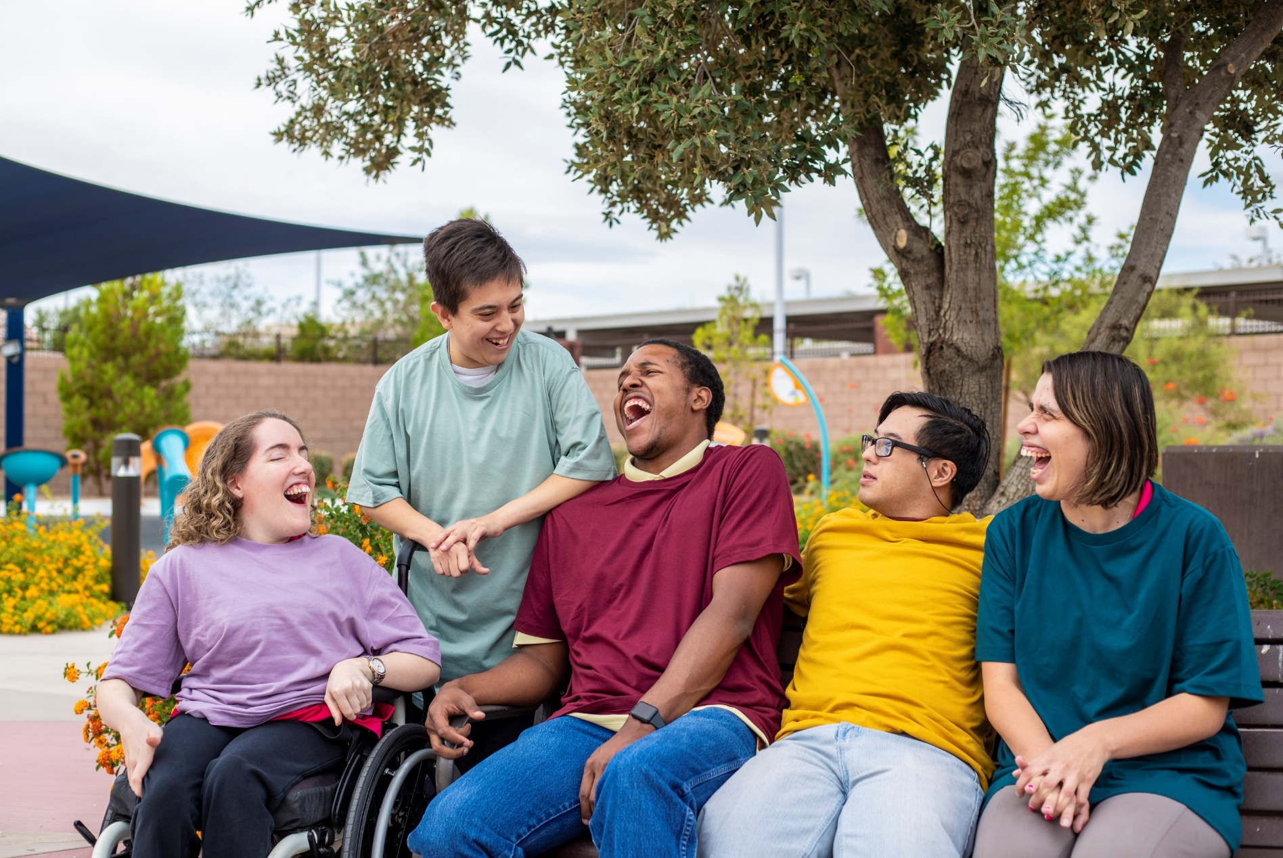
Team Collaboration for Successful Transition

Slide 2
Your collaborative Presenters
Donna Grumiaux
Amanda Dailey
Kendra Johnson
Chris Martin

Slide 3
Schools and DARS
Schools and DARS share a common goal of successful employment outcomes
Federal regulations require schools and DARS to work together to deliver Pre-ETS within the educational setting
Pre-ETS works in conjunction with the school’s existing transition services and are based on the student’s individual need

Slide 4
What are Pre-ETS?
Early start at developing employability skills and to assist students with identifying career interests
Only for Students With Disabilities
Do not have to be a DARS client
DARS collaborates with students, families, schools and community service providers

Slide 5
Pre-ETS may be provided to students who…
Are at least 14 AND
Are receiving special education services and have an IEP, OR
Have a Section 504 plan, OR
Have a disability not served by other means from the school and can provide documentation of disability

Slide 6
How are Students Referred for Pre-ETS?
Students can be referred for Pre-ETS by the school, parents, or other service provider
Schools will have the referral form (Pre-ETS Release and Consent form)
Once completed, forms and documentation of disability will be turned in to the DARS counselor

Slide 7
Pre-ETS Activities
There are Five Required Pre-ETS Activities
Job exploration counseling
Work-based learning experiences
Postsecondary education counseling
Workplace readiness training
Instruction in self-advocacy

Slide 8
Pre-Employment Transition Services are the first step on a continuum of Vocational Rehabilitation services provided by DARS.

Slide 9
What happens when a person no longer wants/needs or qualifies for Pre-ETS?
Apply for DARS Vocational Rehabilitation Services (this can happen any time, based on individual need)
  Complete and sign VR application
  Eligibility completed by VR counselor
Look for employment on their own
  Use skills gained through Pre-ETS to look for, secure, and maintain employment
  Still can apply for VR services at any time

Slide 10
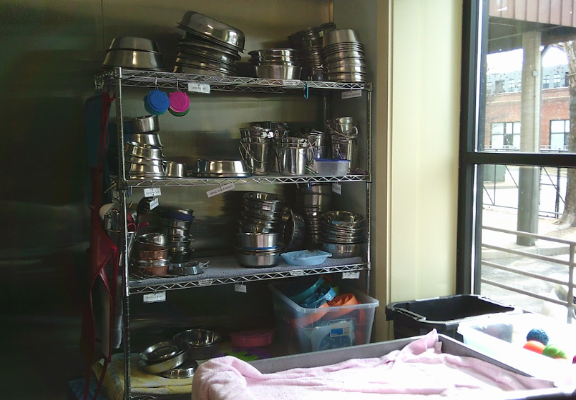
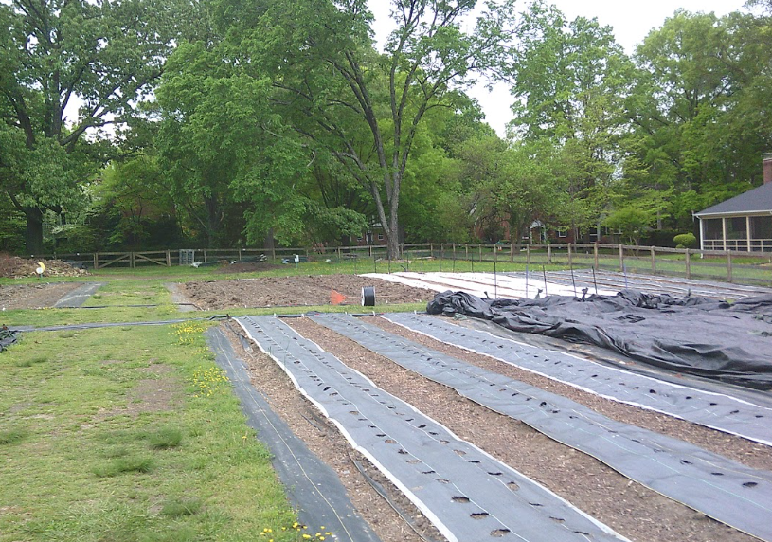
What is PhotoVoice?
Photovoice is as a research methodology.
Photovoice is also a tool for participatory action research that allows participants to communicate their thoughts, emotions, and experiences in a creative and accessible way through photos and reflections.
Students take photos that express their perspective on or views about and feelings around a topic. The pictures are printed and participants select a couple of images to use as a stimulus in a group discussion.
Discussion focuses on why the photographs were chosen, what makes them meaningful, and what participants think about each other’s pictures. The discussion is recorded and transcribed.
Richmond Public Schools | August 16, 2023

Slide 11
Why PhotoVoice?
Participants feel empowered and enriched by being involved in a creative research project, while building social relationships among those involved.
To address personal doubts, such as ‘I can’t draw’, or ‘I’m not creative’ participants are supplied with the means of taking photos.
Participants learn new skills which enable them to tell their stories and communicate these to each other and the wider public.
Photographs capture the lived experience of participants and give insight and deeper understanding about their world.
Participants choose the most important images with optional captions, and are able to use them in a portfolio to lead their transition planning.
Richmond Public Schools | August 16, 2023

Slide 12
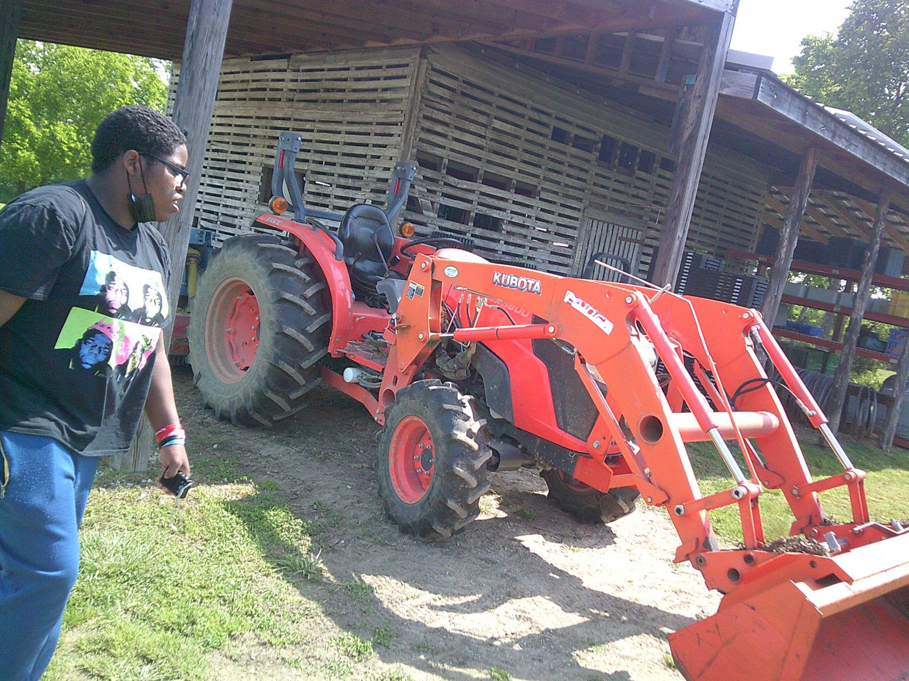
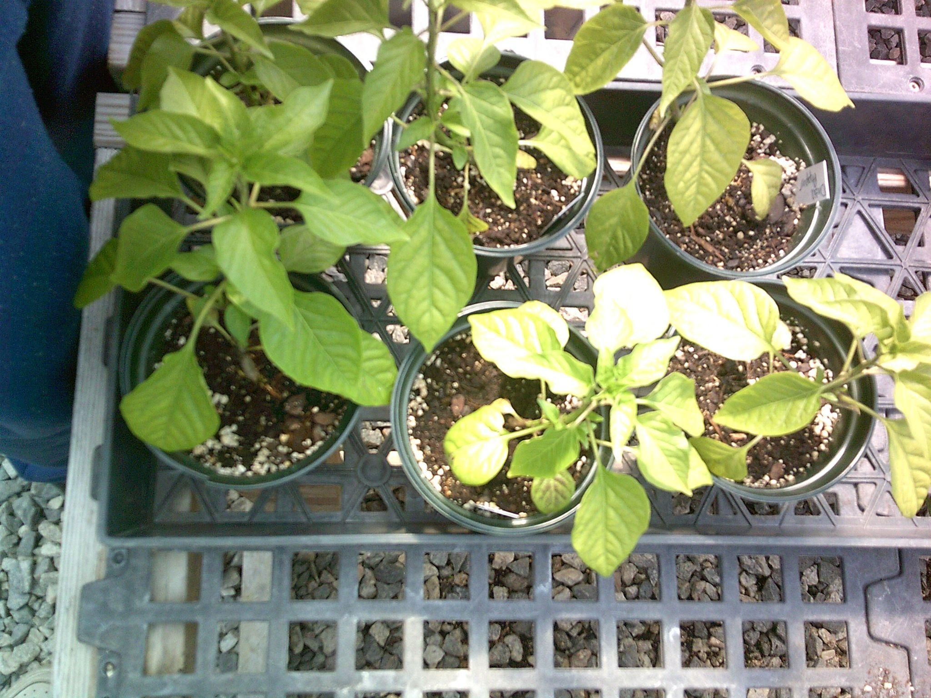
Why PhotoVoice for Employment Assessment?
The Photovoice project challenges the myth that students with disabilities are not interested in employment or have difficulty with being employed.
Visual images can be a powerful communication tool, challenging stereotypes and providing a platform for more intense and emotionally engaging reflection.
Photovoice gives students a visual resume of their experiences to market themselves for potential employers and community partners in order to increase future employment opportunities.
With Photovoice, participants build confidence and learn self-advocacy and communication skills through photography and storytelling training.
It promotes self-expression and the use of language during the reflective process.
Richmond Public Schools | August 16, 2023

Slide 13
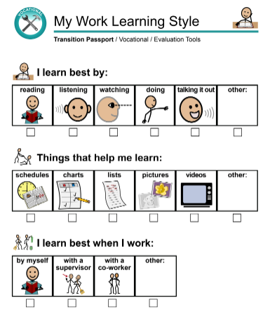
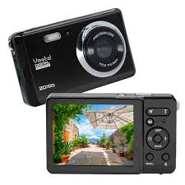
Types of Assessments Used in RPS
Transition Assessments
  Student Work Environment Preferences
  Pictorial Interest Survey
  21st Century Workplace Readiness Skills Checklist
  and Rubric
Self Evaluations
  Positive Work Skills
  Work Learning Style
Transition Planning (Unique n2y GPS)
  Vocational
  Daily Living
  Community
  Lifelong Learning
Digital camera proficiency checklist
Richmond Public Schools | August 16, 2023

Slide 14
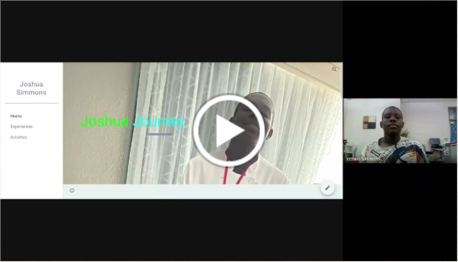

Josh’s Story
Joshua Simmons
Grade 12
Richmond Public Schools | August 16, 2023

Slide 15
Goals & Benefits of the
Integrated Resource Team (IRT)
Goals
Benefits
Enhances cross-agency and cross system collaboration and communication to leverage resources in a more seamless way for individual participants.
Promotes informal collaboration and relationship building among traditional and non-traditional partners.
Allows members to coordinate resources (both financial & non-financial) at the participant level.
Demonstrates the value of collaboration which makes everyone’s job easier
Promotes core rehabilitation values (self-determination & informed choice)
Shared participants, shared resources, and shared outcomes = Shared Accountability
Shared participants & resources = agencies can help more participants
Enhanced cross-agency education through applied learning.
Everyone gets credit for participants’ outcomes
Notes:
Sandi

Slide 16
What is an IRT?
An IRT is initiated on behalf of an individual participant who is experiencing multiple challenges to employment and who will likely need to access multiple resources, supports, and programs across multiple systems, in order to address that one individual’s specific needs.
It brings together a team of diversified service providers, including community and partner agencies, and other traditional and non-traditional partners, who work together with the individual participant to strategize on how services, resources, and supports can be coordinated around that individual to help reach and maintain an employment goal.
The participant, along with the team of service providers, comes together to establish three main components:
  Employment goal
  Lines of communication
  Sequence of services
Notes:
Sandi
The IRT is an informal agreement between a participant and the systems providing services to that participant, allowing the members to coordinate services at the individual participant level around a shared employment goal.
The “team” approach promotes greater systems collaboration and increases cross-agency education and accountability of all parties involved in the IRT, including the participant.
Additionally, all IRT members may collectively gain credit for the participant’s employment outcome.

Slide 17
What an IRT Is/Is Not…
What an IRT Is:
  An approach focused on a specific individual participant who is present and an integral part of the team.
  Each IRT is unique and members of the IRT will change with each new IRT that is formed
  The main purpose of an IRT is EMPLOYMENT.
What an IRT is NOT:
  an interagency committee consisting of various disability/community agencies who focuses on systemic or community-level issues where membership and participation is consistent and static
  a multi-stakeholder group who comes together to talk about and/or “staff” current or potentially shared participants.
  Business as usual (i.e. VR Counselor, VR-Paid Provider & Participant).
Notes:
Sandi

Slide 18
Who Might Participate in an IRT?
In addition to the participant (who is always present at an IRT meeting), an IRT may consist of a wide range of community partners, contracted providers, and/or others based on the participant’s individual and unique needs and preferences.
*This is not an exhaustive list
Community Work Incentive Coordinator
Housing Provider
Independent Living Center
Workforce Partners
Community Rehabilitation Providers
Faith-Based Organization
Volunteer Network
Natural Supports/Family
Representative Payee
Peer/Family Mentor
Vocational Rehabilitation Counselor
Developmental Disability Specialist
Behavioral Health Specialist
Medicaid Waiver Case Manager
Supported Employment Specialist (including contracted providers)
Local School District
  Special Education Coordinator
  Special Education Teacher
  Paraprofessional
Small Business Administration
Self Employment Specialist
Notes:
Sandi

Slide 19



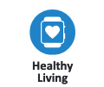


Charting the Life Course Life Domains
Daily Life & Employment
What a person does as part of everyday life-school, employment, volunteering, communication, routines, life skills.
Advocacy & Engagement
Building valued roles, making choices, setting goals, assuming responsibility and driving how one’s life is lived.
Community Living
Where and how someone lives – housing and living options, community access, transportation, home adaptations and modifications.
Social & Spirituality
Healthy Living
Managing and accessing health care and staying well – medical, mental health, behavioral health, developmental, wellness and nutrition.
Building friendships and relationships, leisure activities, personal networks, and faith community.
Safety & Security
Staying safe and secure – emergencies, well-being, guardianship options, legal rights and issues.
https://www.lifecoursetools.com/lifecourse-library/exploring-the-life-domains/
Notes:
DJ
© Copyright PresentationGO.com – The free PowerPoint template library

