Slide 1
Supporting Transition with Photovoice and Digital Employment Portfolios in Intensive Supports Classrooms
Molly Taylor, LaNeka Brown, Richard Chapman, Tammy Sellers, Amanda Dailey, Joshua Simmons, Arren Lee, & Seb Prohn

Slide 2
TABLE OF CONTENTS
01
02
03
04
Project PEACE
Photovoice
Digital Portfolios
Hear from students!

Slide 3
INTRODUCTION
What is Project PEACE?
Promoting Employment After high school through Community Experience
Community-based capacity building project designed to increase the employment of persons with IDD
Grounded in the lived experiences of community members

Slide 4
OUR PROCESS
WBL
PORTFOLIOS
A
B
C
D
PHOTOVOICE
EMPLOYMENT
Notes:
Grounded in what classrooms are already doing or should be doing more of: work-based learning
The remainder of this process leverages work-based learning experiences so students get more out of those learning opportunities and can translate them into competitive employment
Step 2: photovoice- classroom-based curriculum incorporating photography for career exploration and discovery
Translates into step 3: digital portfolios which serve as a transition and employment tool
Of course, this all ends in our goal for students and the goal students have for themselves: employment

Slide 5
PHOTOVOICE
Paired with WBL experiences
Designed to support those with the greatest support needs
Arts-based participatory research method
8 high school students in Intensive Support classroom participated in research
5 1-hour sessions including training and student interviews
https://drive.google.com/file/d/121wenf46HqNhuLS4UHdo7MxFYAh8MdYU/view?usp=sharing
Notes:
We’re going to start with discussing photovoice. It is an arts-based participatory research method that used photography to help participants tell their own stories. Like I said, this built off of work-based learning so students took photos during any and all work-based learning experiences (including in the classroom)
We used photovoice because of its promise of an inclusive, accessible way to hear the lived experiences of marginalized students, especially those with IDD
We implemented photovoice in an Intensive Supports high school classroom and while all 15 students participated in the curriculum, 8 students consented to participate in our research study.
Photovoice consisted of 5 1-hour sessions which included training on photography and lots of career exploration activities in combination with that training.
For the last two sessions we interviewed students about their photos and the meaning behind them.

Slide 6
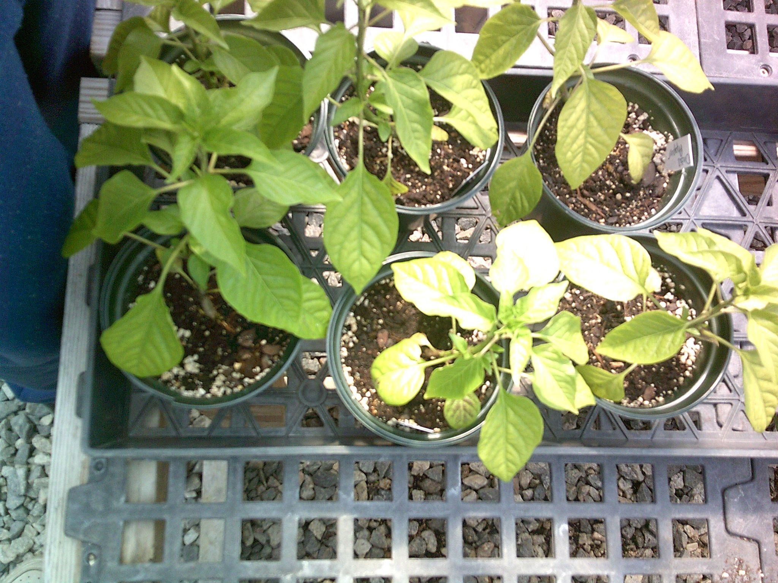
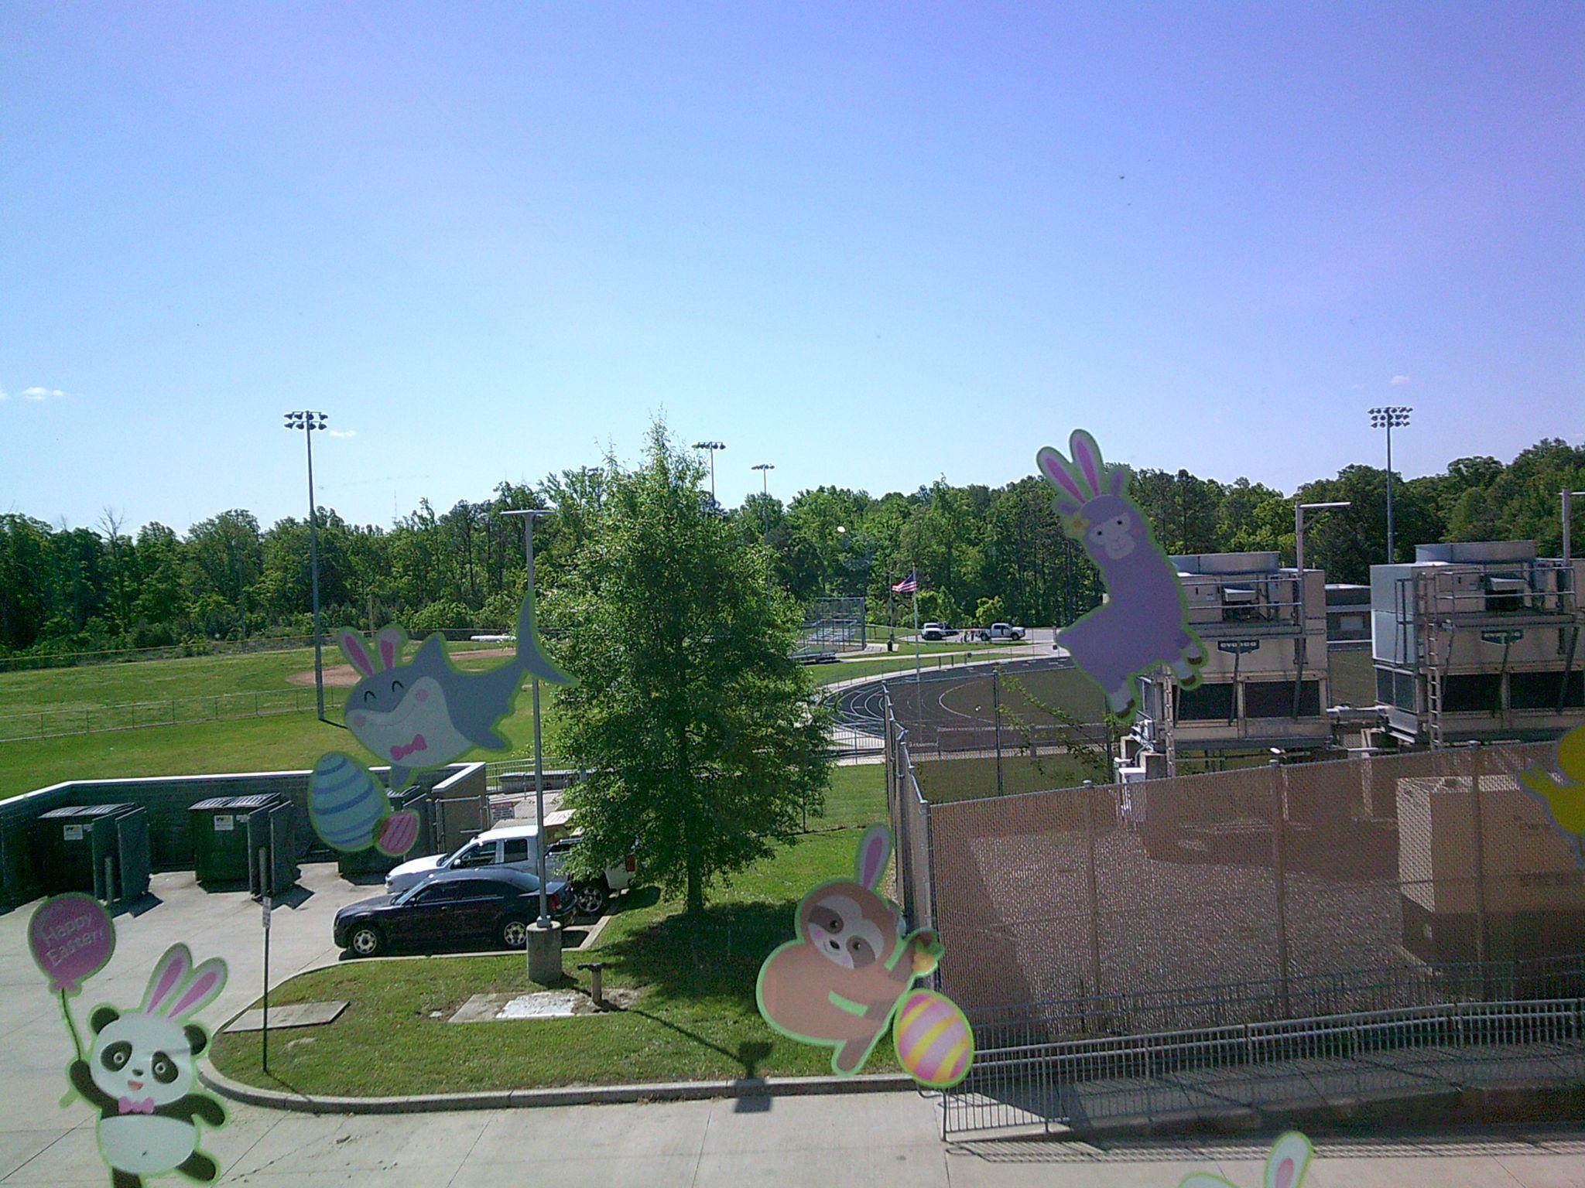
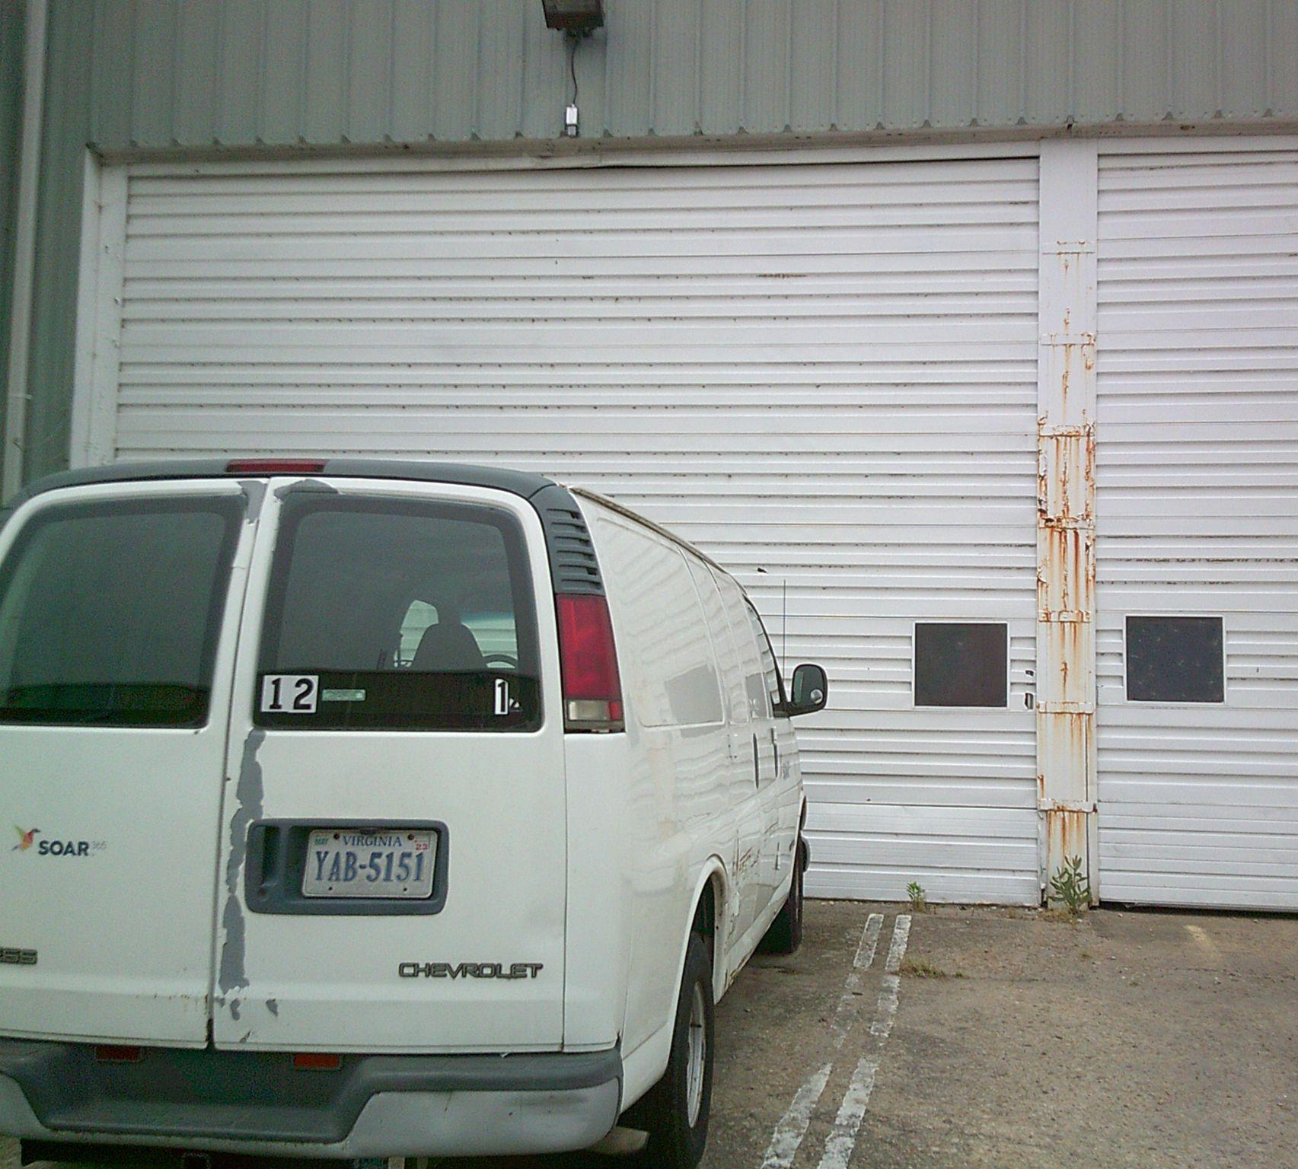
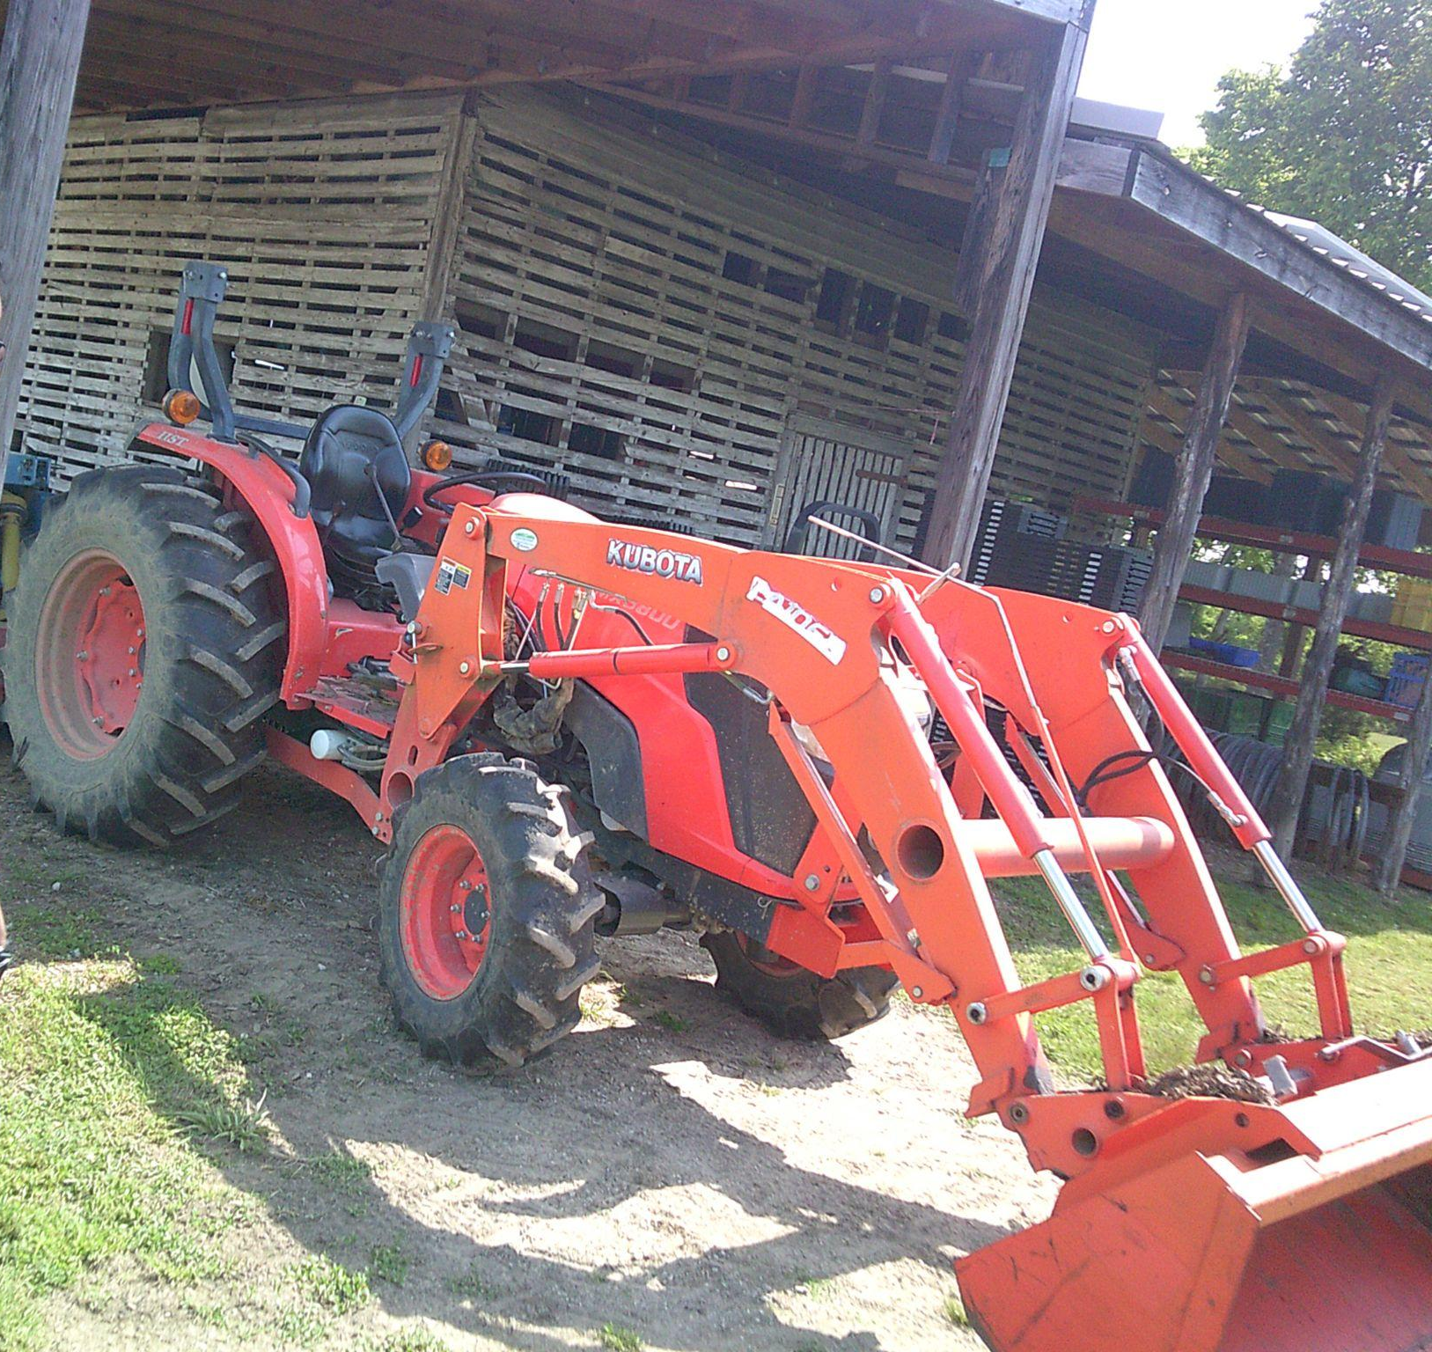
PHOTOVOICE OUTCOMES
Students’ explored and identified a wide range of employment goals and preferences including:
Landscaping
Art
Culinary Science
Pet Grooming
Truck Driving/Loading
And many more!!
Notes:
So we wanted to share a few photos with you that students took at their work-based learning sites and just show the diversity of career interests and preferences.

Slide 7
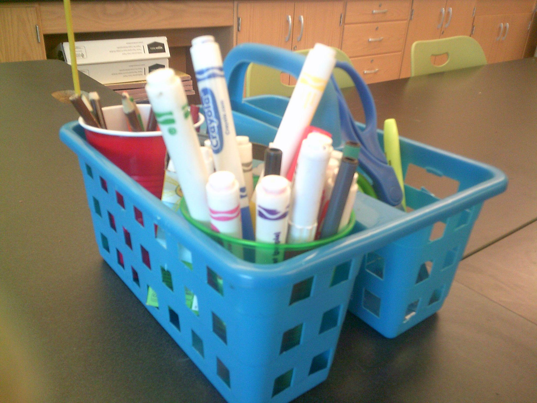
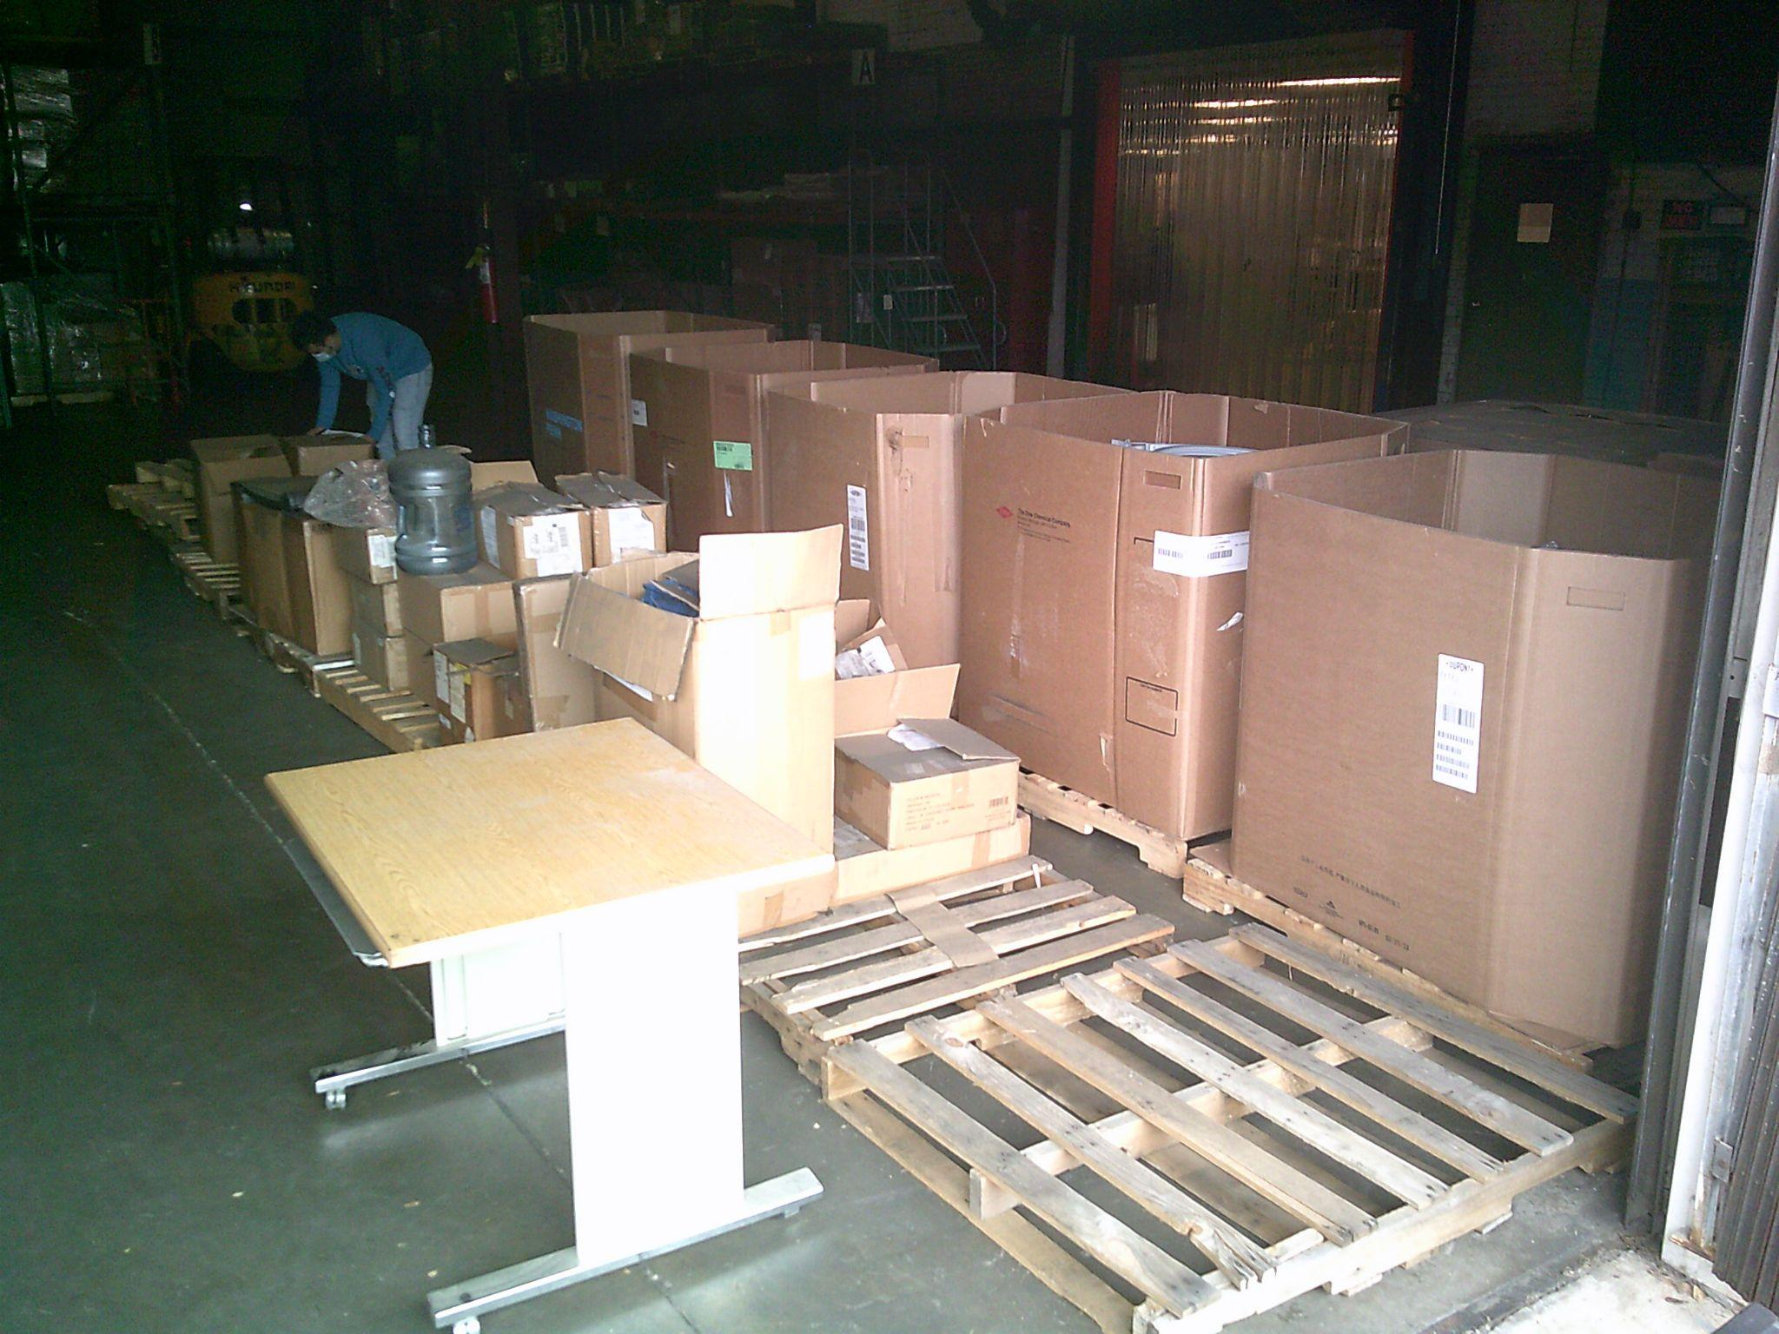
PHOTOVOICE OUTCOMES
Students took photographs related to their employment goals and experiences.
All students communicated their work goals, preferences, and accommodations through discussions around photographs.
Notes:
A powerful outcome of photovoice was that students communicated through their photos, communication boards, interviews, and other materials their work goals, preferences, NEEDS, and learning tools, which ultimately promoted self-advocacy and self-efficacy.

Slide 8
DIGITAL PORTFOLIOS
Leveraging photovoice to create a transition & employment tool
Google Classroom & Google Sites
Notes:
LaNeka

Slide 9
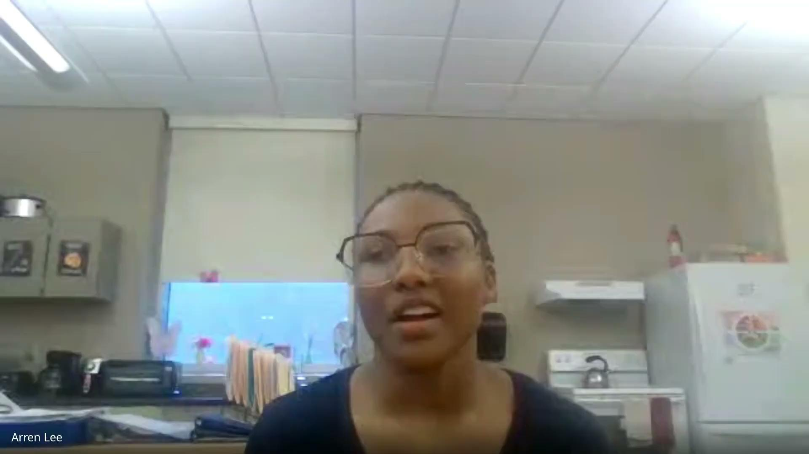
STUDENT PORTFOLIOS!

Slide 10
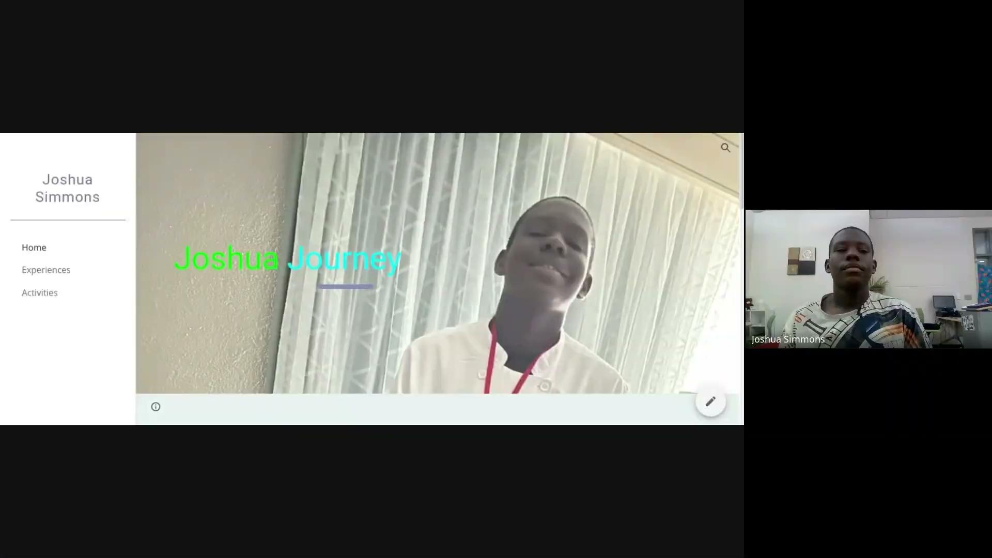
STUDENT PORTFOLIOS!

Slide 11
STUDENT-LED RESEARCH & TRANSITION
IMPLICATIONS
HOW TO LEVERAGE PHOTOVOICE AND PORTFOLIOS
Notes:
We wanted these processes to be as student-led as possible: students chose what photos to take, which photos to discuss during their interviews (and at the gallery), they chose what they wanted to include in their portfolios, what their portfolios looked like, ect… which made transition engaging!!!
Now the important part: how to leverage these tools: students used portfolios to help lead their own IEP meetings, teachers can use them to match students to job opportunities and to customize curriculum, students can share their portfolios with employers at job fairs and in applications/interviews

Slide 12
THANK YOU!
For questions, please reach out to:
taylorml9@vcu.edu or projectpeace@vcu.edu

