Slide 1
How to Use a Photovoice Curriculum for Career Exploration in Your Intensive Supports Classroom
Molly L. Taylor, Ph.D. Candidate, Virginia Commonwealth University
LaNeka Brown, Project Coordinator, Partnership for People with Disabilities
Tammy Sellers, Intensive Support Mentor Teacher, Richmond City Public Schools
Amanda Dailey, Intensive Support Mentor Teacher, Richmond City Public Schools

Slide 2

What am I getting out of this session?
Define Photovoice
Discuss how Photovoice supports Career Exploration
Review our Photovoice Implementation Guide for career exploration
Go home with the full guide for use in your classroom!

Slide 3
Project PEACE
Promoting Employment After high school through Community Expertise
Community-based capacity building project designed to increase the employment of persons with IDD
Grounded in the lived experiences of community members
Project PEACE was supported in part by grant number 90DNCE0004-01-00, from the U.S. Administration for Community Living, Department of Health and Human Services, Washington, D.C. 20201.

Slide 4

What is photovoice?
A participatory, qualitative research method
Designed to support those with the most complex needs
Students take photos of their Work-Based Learning (WBL) experiences to communicate their strengths, preferences, interests, and needs around employment

Slide 5
Why use Photovoice?
Participants feel empowered and enriched by being involved in a creative research project, while building social relationships among those involved.
To address personal doubts, such as ‘I can’t draw’, or ‘I’m not creative’ participants are supplied with the means of taking photos.
Participants learn new skills which enable them to tell their stories and communicate these to each other and the wider public.
Photographs capture the lived experience of participants and give insight and deeper understanding about their world.
Participants choose the most important images with optional caption.

Slide 6

How does it relate to Career Exploration?
Photovoice gives students a visual resume of their experiences to market themselves for potential employers and community partners in order to increase future employment opportunities.
With Photovoice, participants build confidence and learn self-advocacy and communication skills through photography and storytelling training.
Visual images can be a powerful communication tool, challenging stereotypes and providing a platform for more intense and emotionally engaging reflection around careers.
The Photovoice project challenges the myth that students with disabilities are not interested in employment or have difficulty with being employed.

Slide 7

Employment for All Using Photovoice

Slide 8
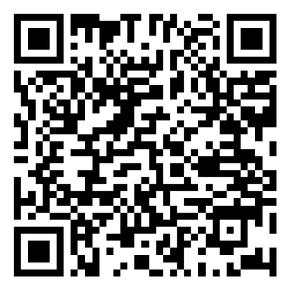
FREE!!
Photovoice Implementation Guide

