Slide 1


Don’t Wait–Create!
Acting Now to Build Work-Based Learning Opportunities
Colonial Heights High School

Slide 2
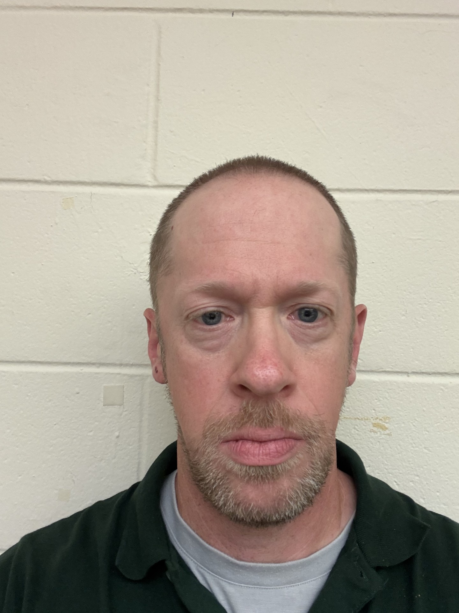

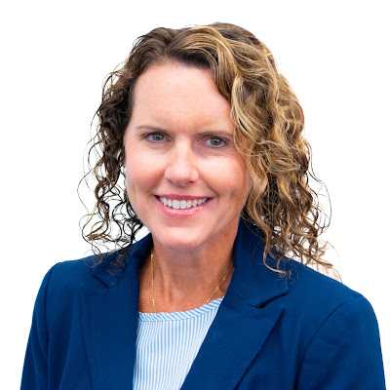
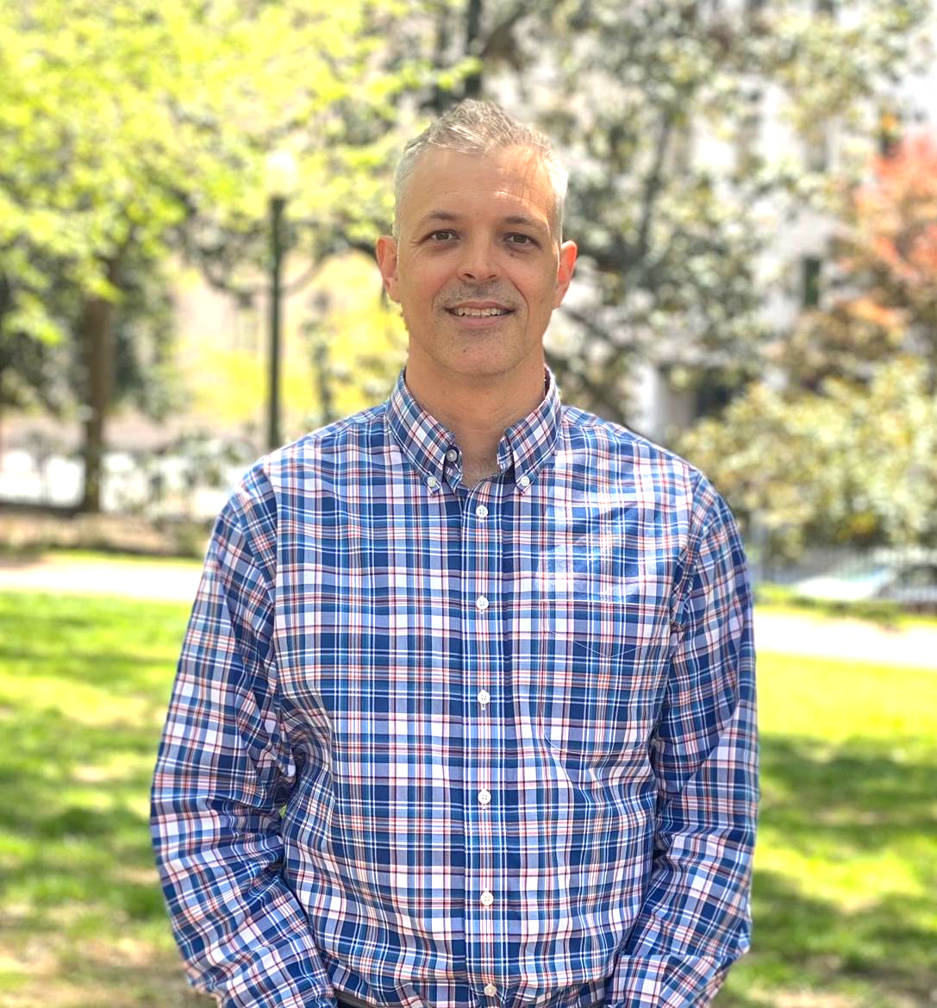
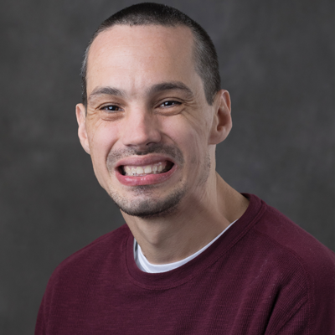
Introductions
Dan Pulskamp Lead Teacher Colonial Heights High School | Dana Barefoot Family Resource Coordinator Colonial Heights Public Schools | Christy George Director of Support Services Colonial Heights Public Schools | Seb Prohn Project PEACE VCU Partnership for People with Disabilities | Richard Chapman Project PEACE VCU Partnership for People with Disabilities

Slide 3

Presentation Goals
Show how planning and building work-based learning experiences can occur simultaneously
Describe community planning practices
Highlight the development of
  Student-led enterprise
  School-based work experiences
  Community work
Build something new!

Slide 4

Agenda
Introductions
Stage setting
Agenda & presentation goals
Project PEACE overview
Community Planning Processes
Colonial Heights- who are we?
Work-based learning
Lessons
Recommendations
Questions & Contacts

Slide 5


Slide 6
Project PEACE
Promoting Employment After high school through Community Expertise
Community-based capacity building project designed to increase the employment of people with IDD
Grounded in the lived experiences of community members
Project PEACE was supported in part by grant number 90DNCE0004-01-00, from the U.S. Administration for Community Living, Department of Health and Human Services, Washington, D.C. 20201.

Slide 7





Partners

Slide 8
Planning Processes
Community Conversations
Community Collaborative
Part of a community landscape analysis process meant to identify community assets, and barriers to improve employment opportunities for students with intellectual disabilities
We conducted three community conversations.
Apply lived experience and perspectives to recommend activities and processes to improve transition to employment
Apply expertise of, Colonial Heights, Assets & Barriers
Develop a plan for community employment to be collaboratively reviewed and revised.

Slide 9



Simultaneous Planning and Doing

Slide 10
Colonial Heights Public Schools
Context

Slide 11
Colonial Heights in Context
CHPS consists of 5 schools, one high school, one middle and three elementary schools with a total population of 2,900 and 571 students with disabilities. The city of Colonial Heights is just south of Richmond and made up of 7.8 square miles.
CHHS has 850 students. We have a Tech Center that offers 30 CTE courses. Our students also attend Northstar Career Academy and Project SEARCH. Many of our in person community program became dormant during COVID. All 5 schools are accredited

Slide 12
Colonial Heights WBL Timeline
Initiative | Fall 2023 | Spring 2024 | Fall 2024 | Spring 2025 | Fall 2025 | Spring 2026 | Fall 2026
Project SEARCH
Student-Led Enterprise
School-based Work Experience
Community work experiences
Community Work Outcome Planning
WBL Professional Development
Notes:
2022
Coming out of COVID. Project SEARCH planning committee
2023
Project PEACE begins at CHPS
Student Led Enterprise PD begins in conjunction with Project PEACE
Coffee Cart Started
First cohort of Project SEARCH
Community Conversations begin
2024
Colonial Heights Library
Parks and Rec Therapeutic Programs
CHHS Copies
In House Vocational Coaching
Coffee Cart and Community Tour of facility
Community Conversations and Collaborations ongoing. Many vocational ideas come about as a result of Community Conversations
2025
Summer- CTI workshop on vocational programming for HS, MS, Elementary and Paras
Copies
Kelmarbi Farms
Dunlop House

Slide 13




Three Key Considerations
Stepping Stones
Persistence
Collaboration

Slide 14
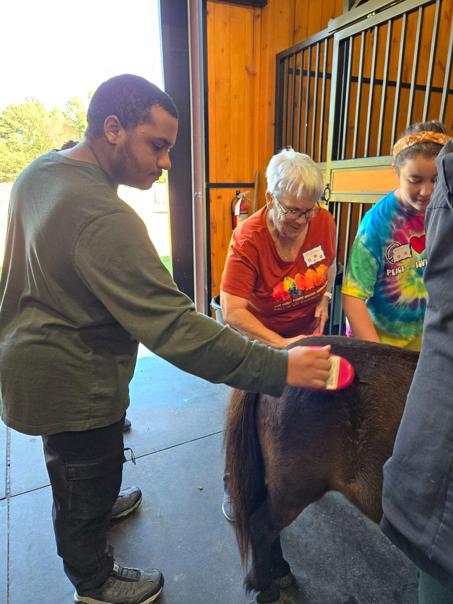
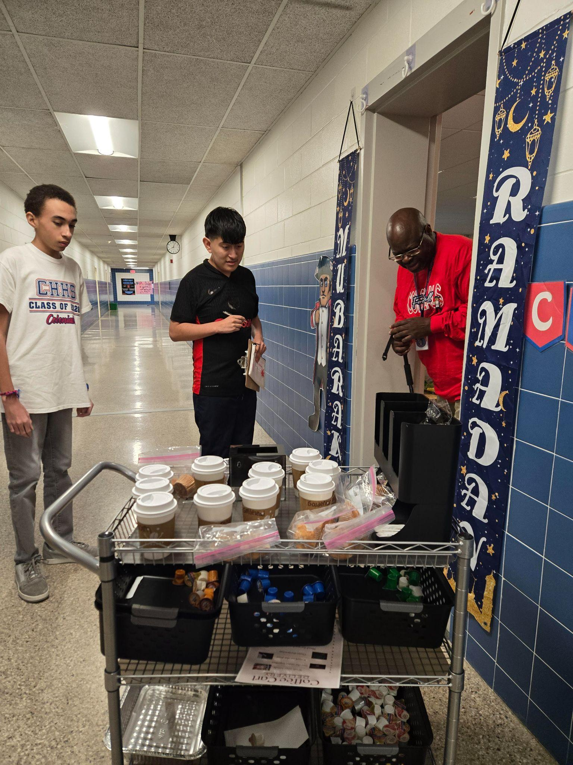
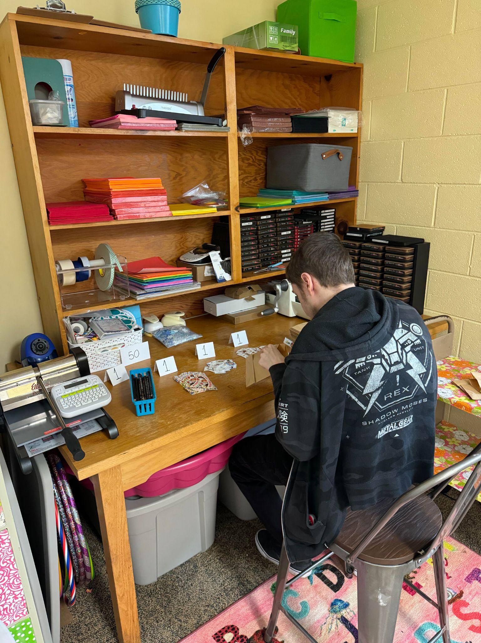
Work Based Learning
Lessons Learned and Practical Strategies

Slide 15
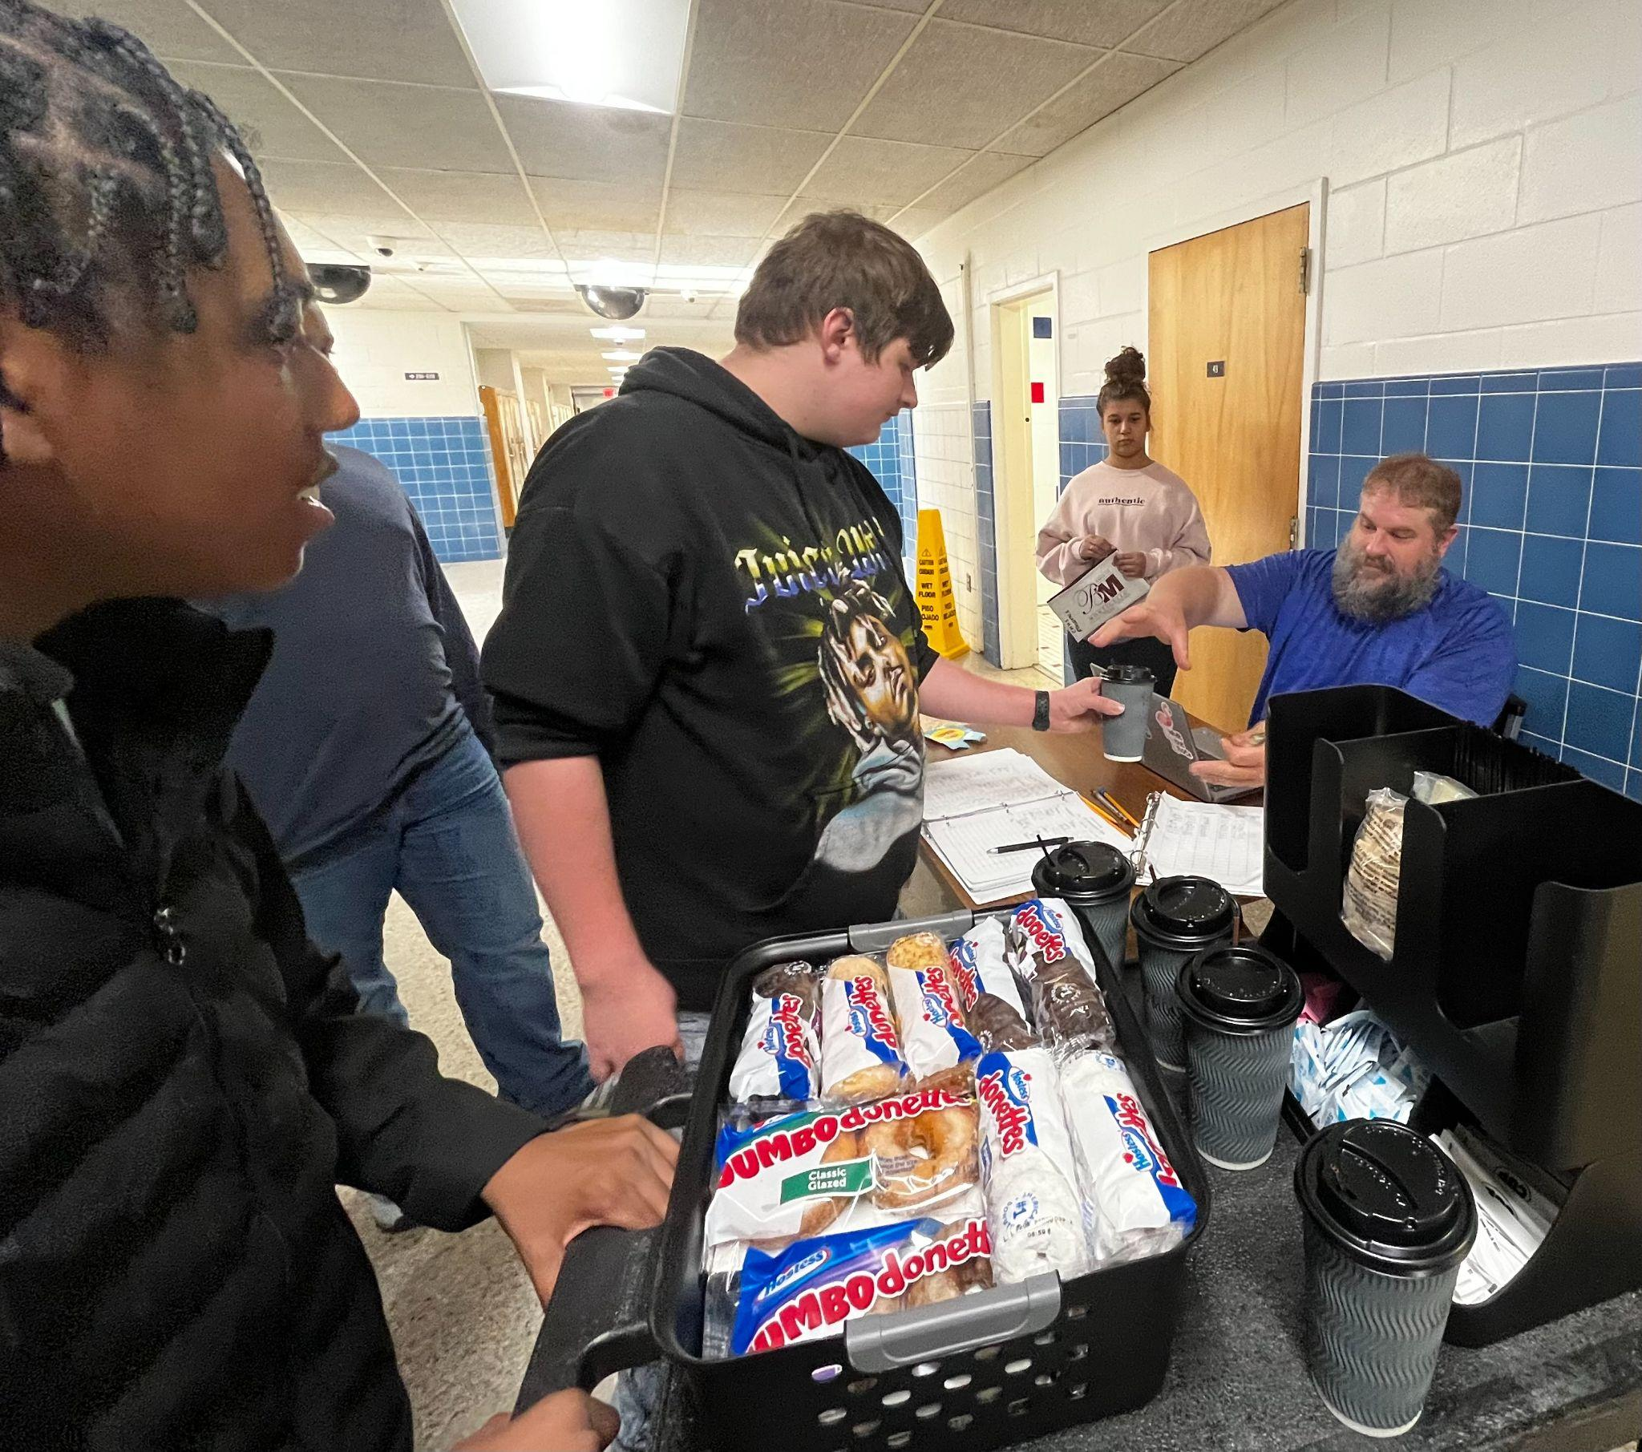
Student-Led Enterprise
Colonial Coffee

Slide 16
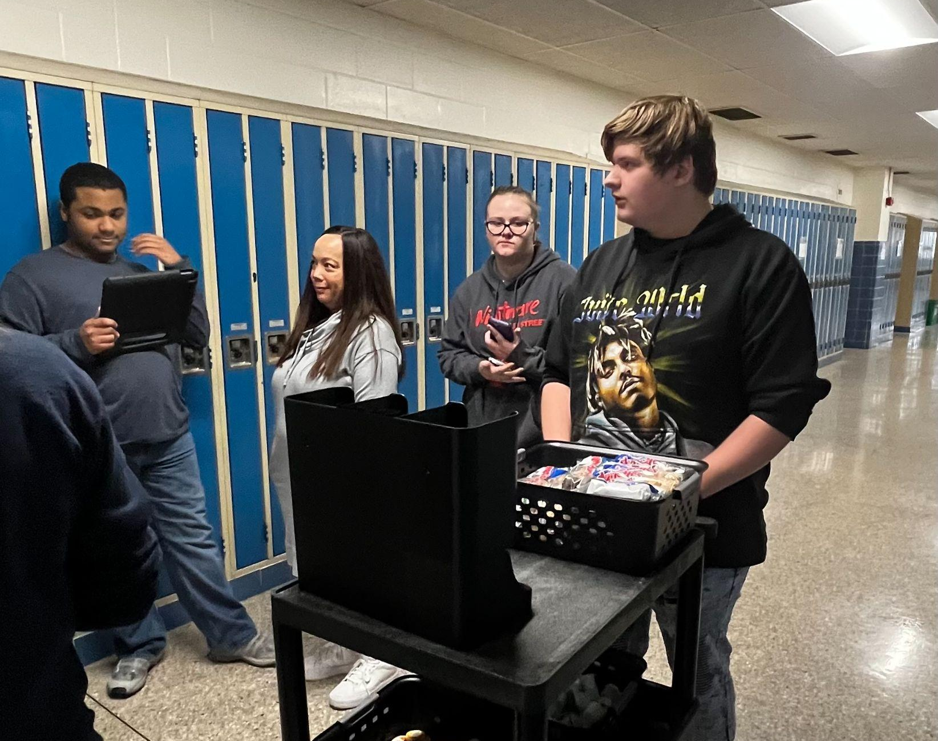
Lessons Learned
Plan Ahead- Because of financial cost, forward planning was critical
Start-up Costs
Layout/logistics of school
  Kitchen Space
  2 Separate Buildings
  Size of Coffee Makers
Student abilities
  Nonverbal students
  Physical challenges
Successes and limitations
CTI Student-led enterprise strategies

Slide 17
Recommended Strategies
Survey staff to see what ideas/services they would be receptive towards
Determine strengths of students
    Job Applications
    Peer Mentors
Compile list of resources/training ahead of time
Find training as it may help you broaden scope of venture

Slide 18
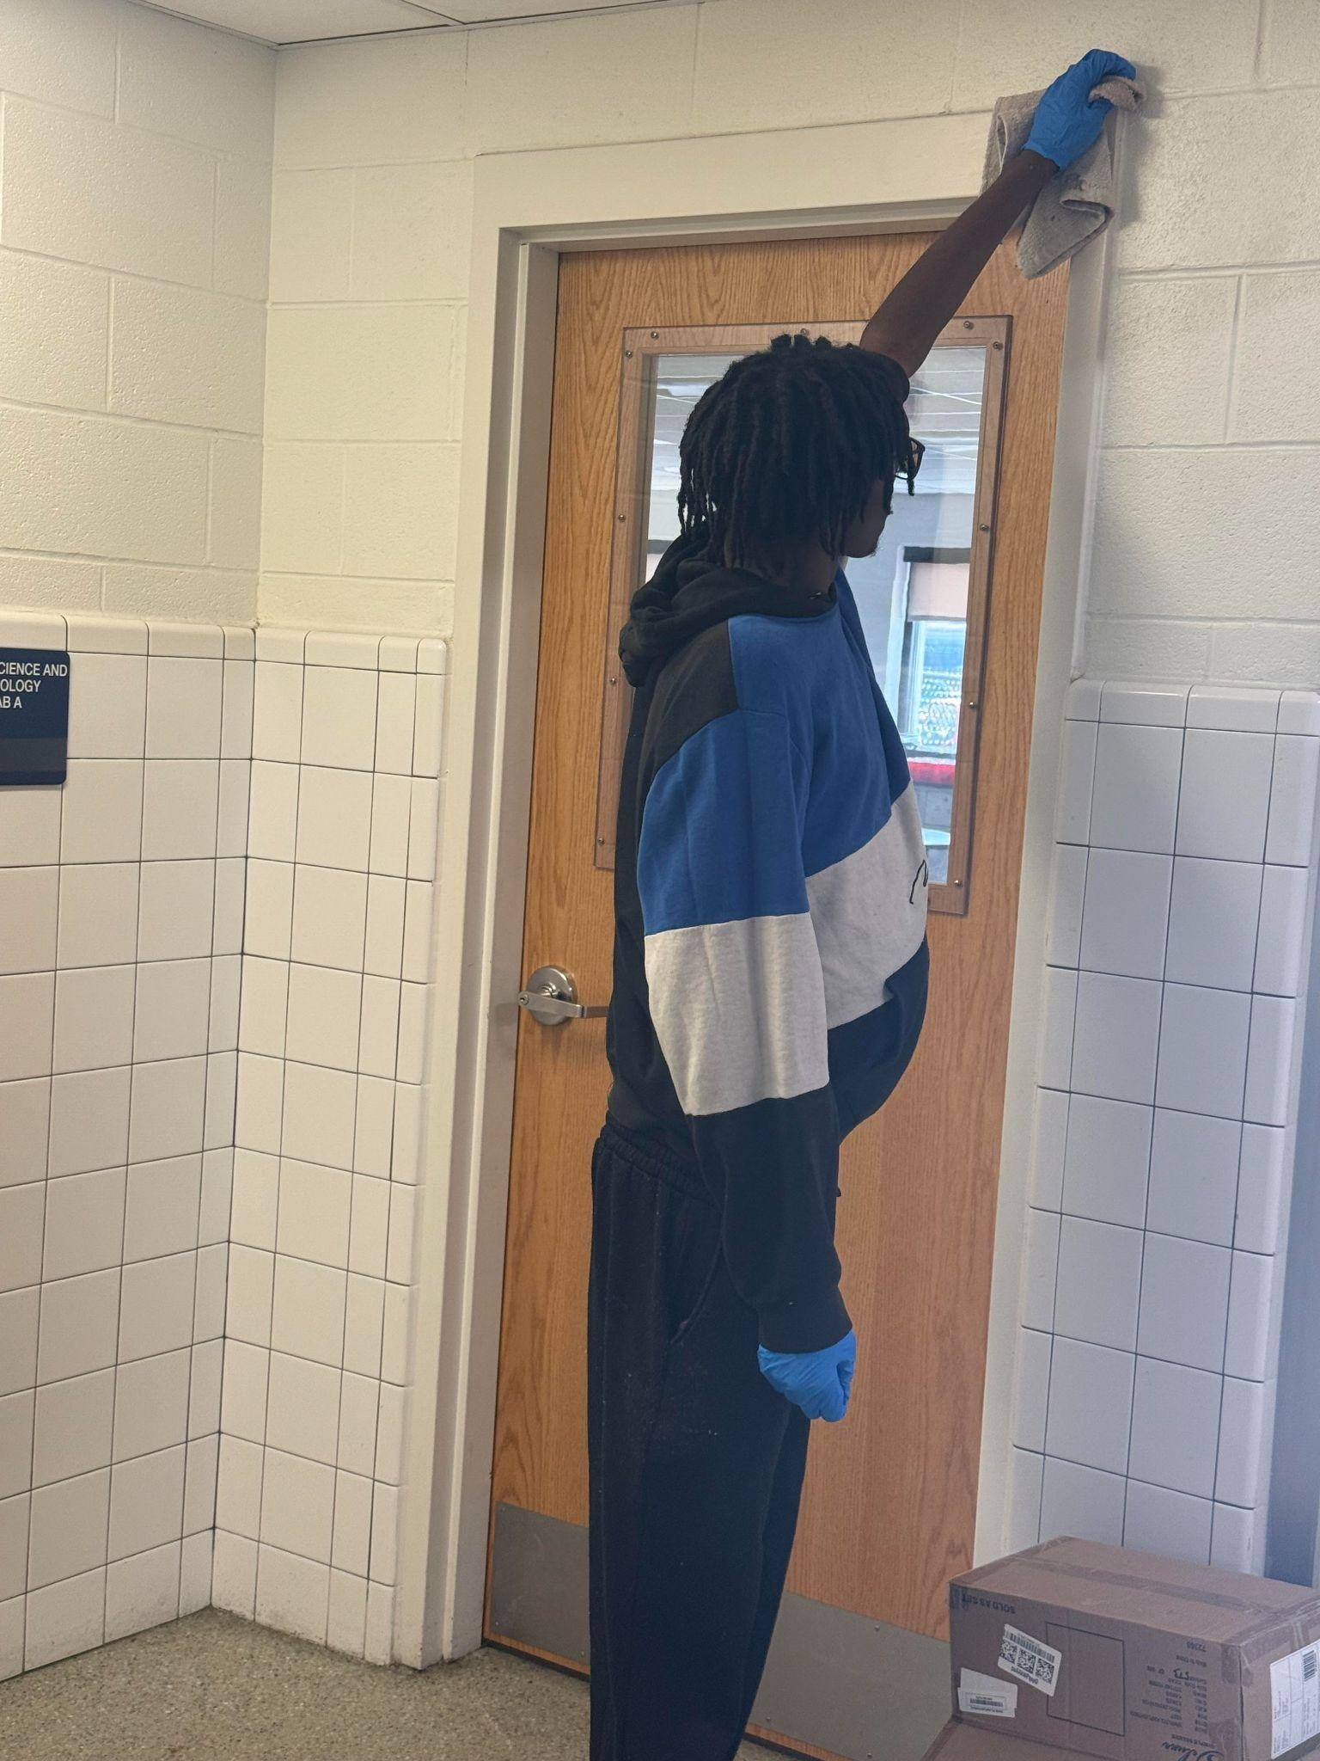
School-Based Work Experiences

Slide 19
Recommended Strategies
Be creative!
  The perfect task may not exist. You may have to create/identify opportunities
  70/30 Rule
Find Staffing
Identify common/regular tasks that are done in school. This creates a regular work flow
Successes and limitations- learning about student strengths; opening new opportunities; useful information for DARS

Slide 20
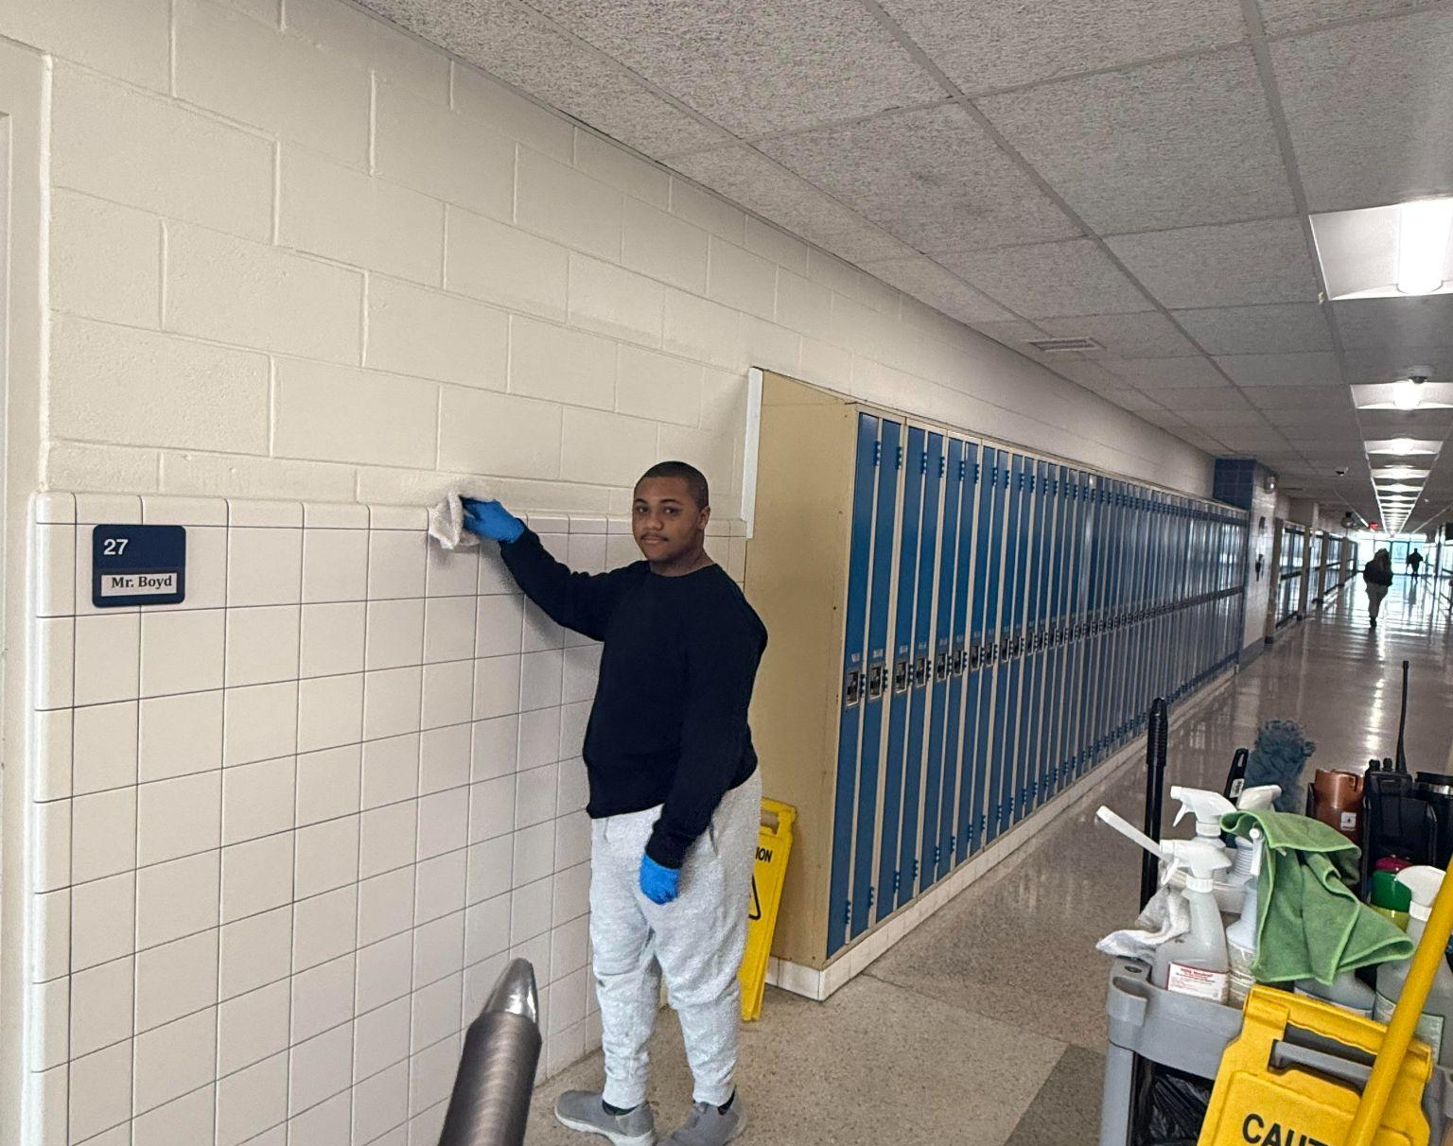
School Based Work Opportunities
Run copy machine
Take out recycling
Work with custodial staff
Work in media center
Matching- strengths and opportunities

Slide 21
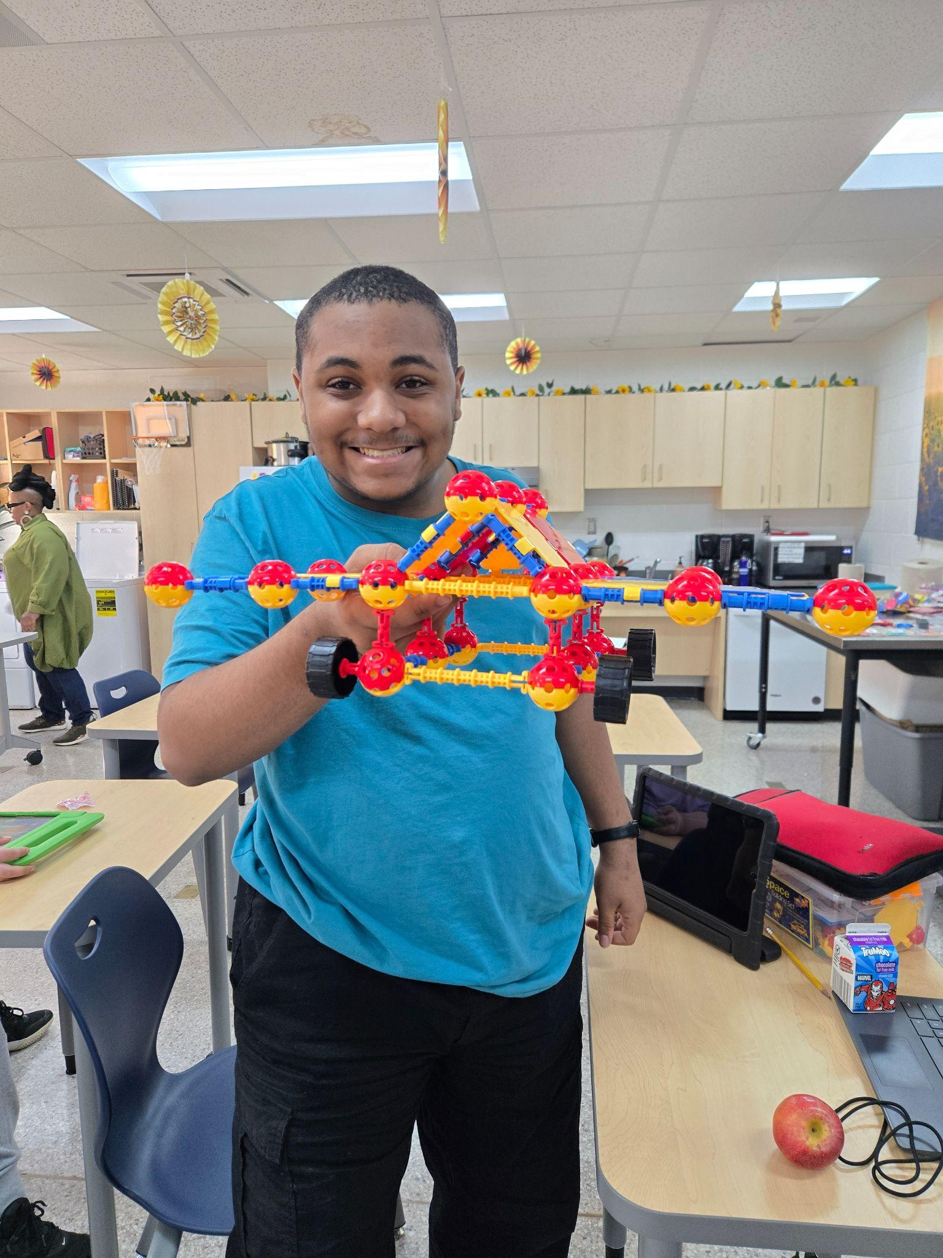
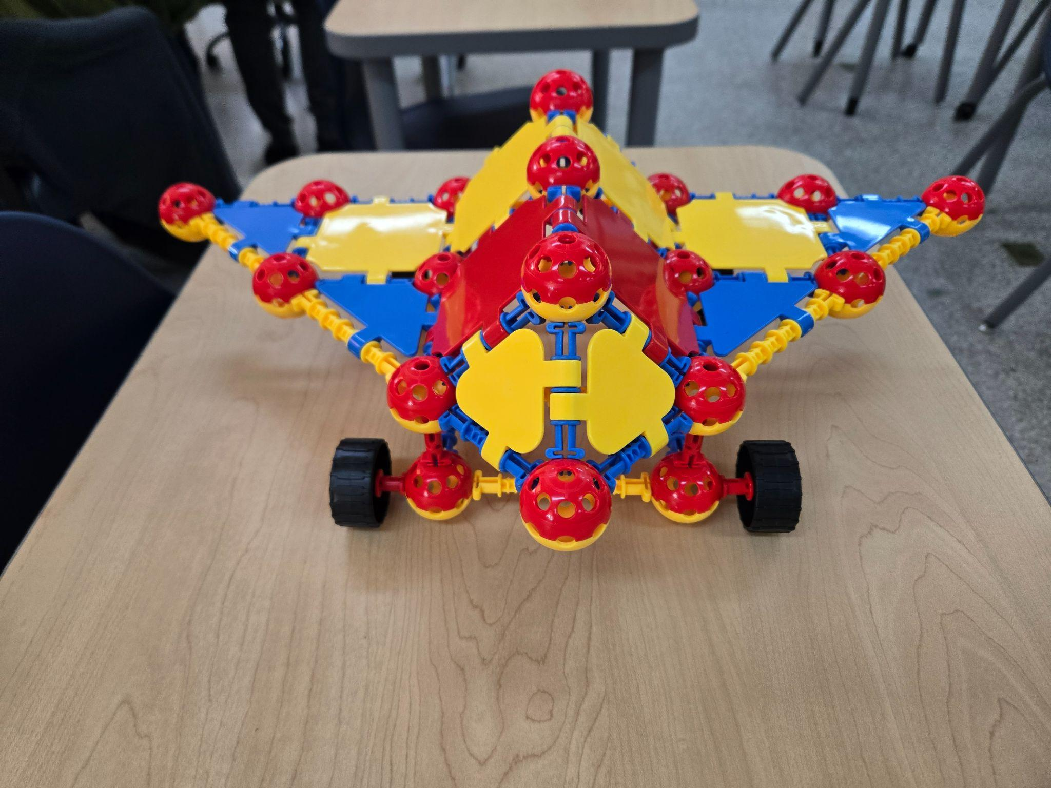
Caeleb

Slide 22
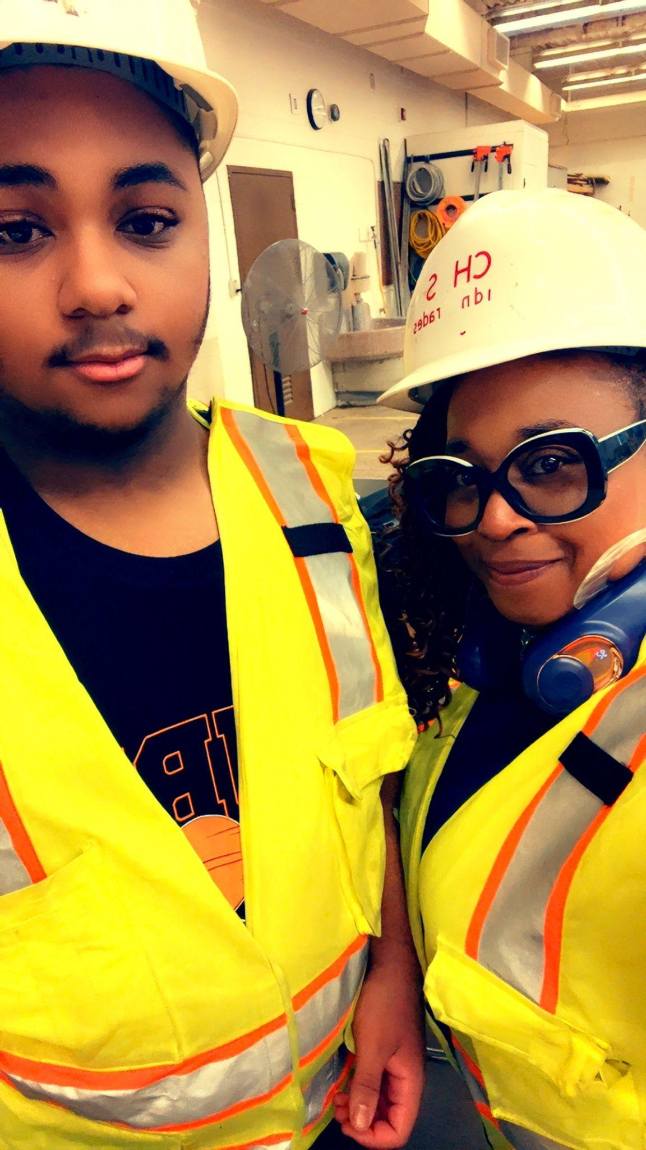

Slide 23
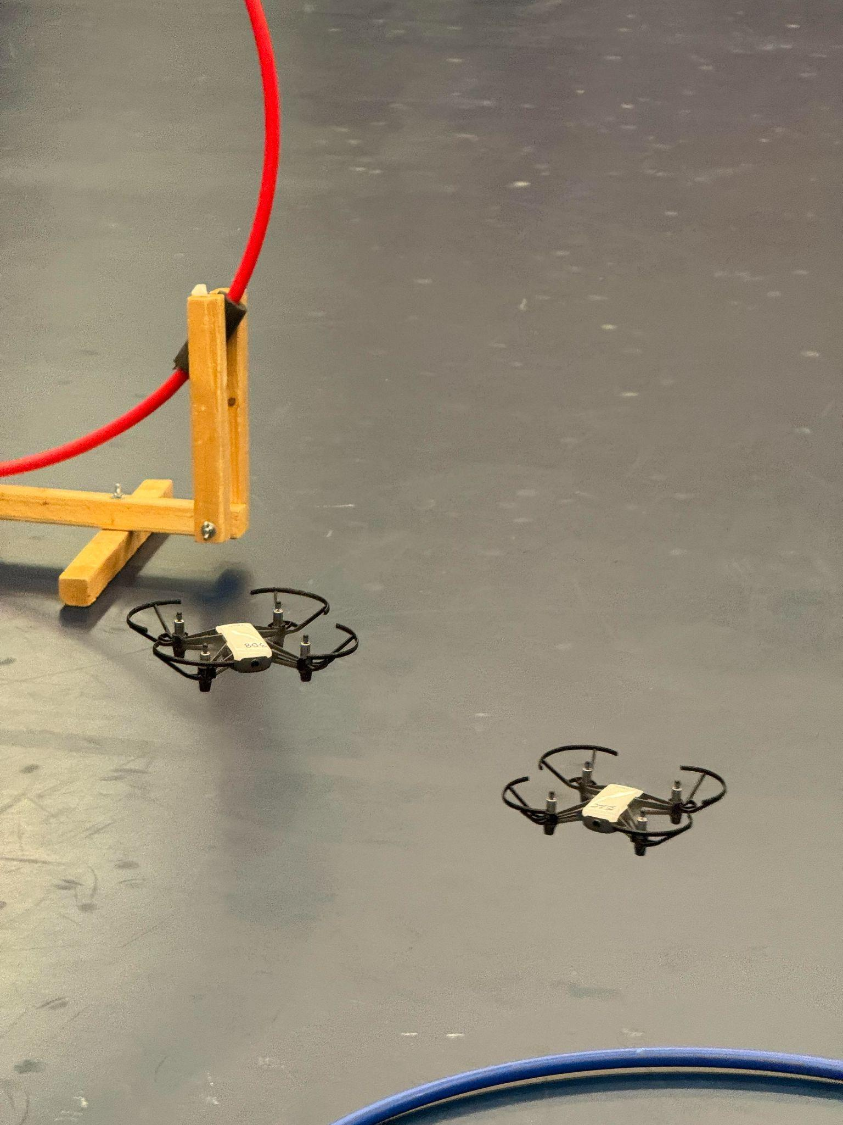
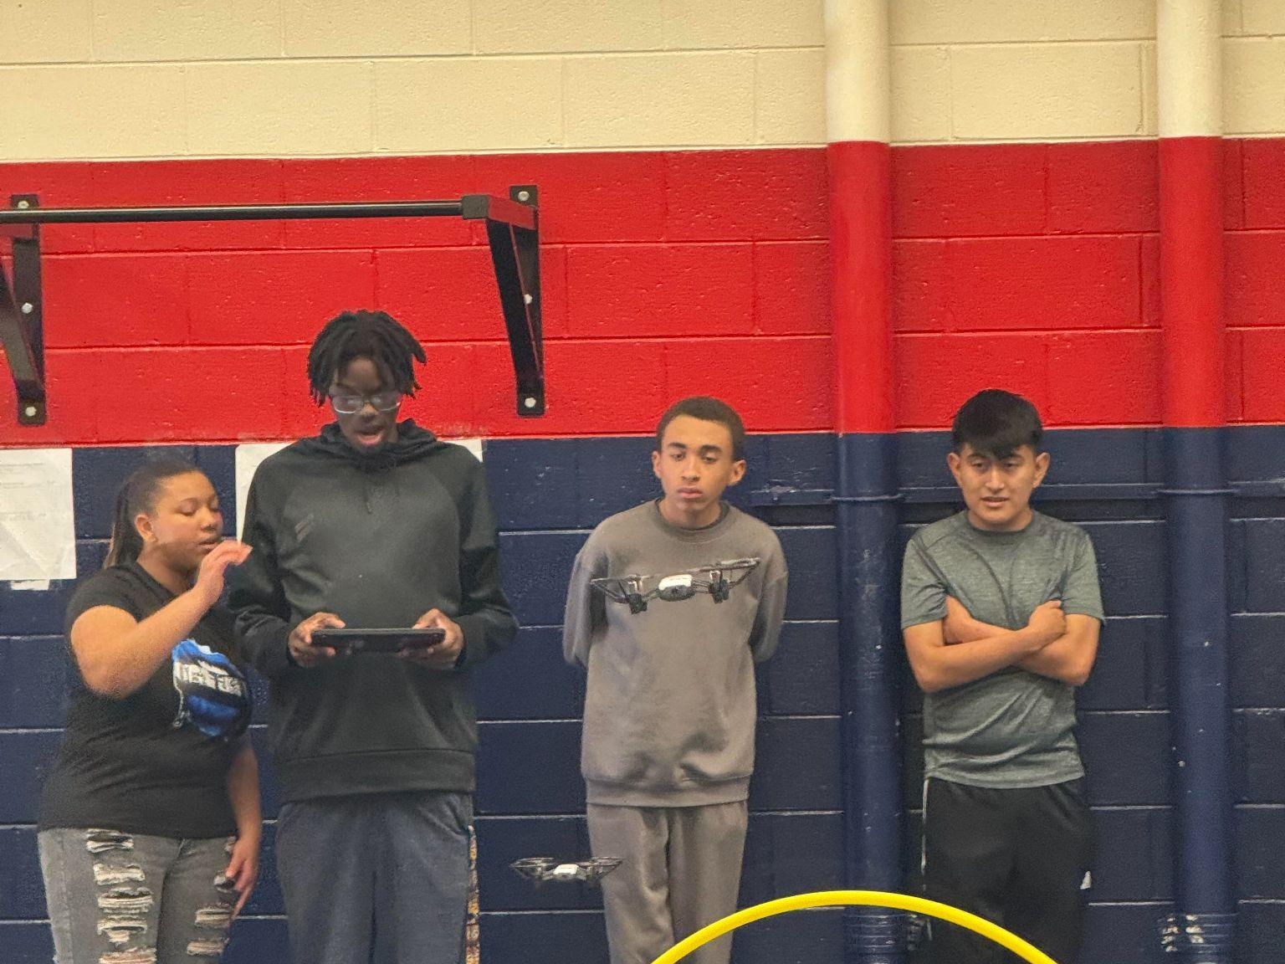
Moseh

Slide 24
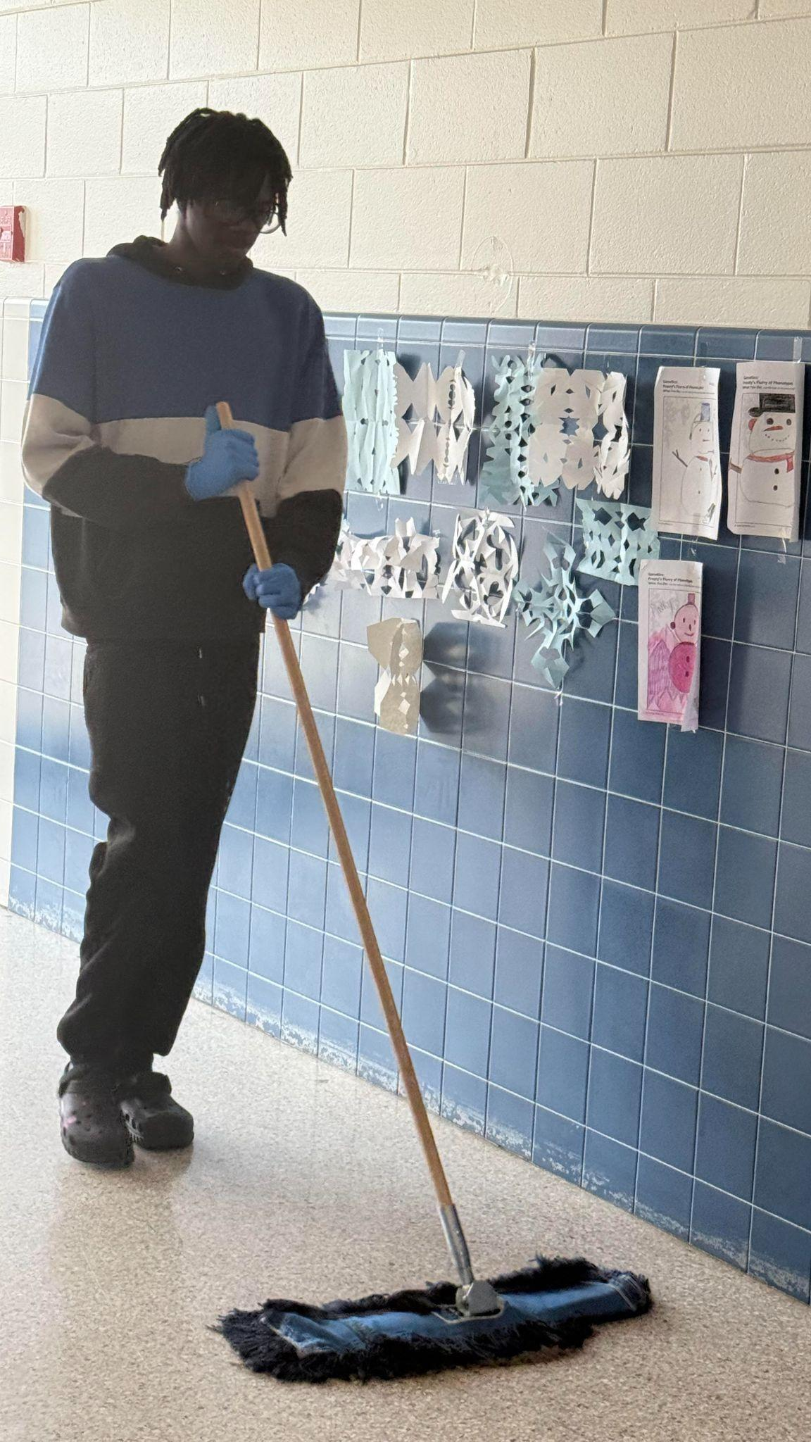

Slide 25
Lessons Learned
Creativity Counts
Fit the tasks to the students
Have students apply to work, even in school

Slide 26
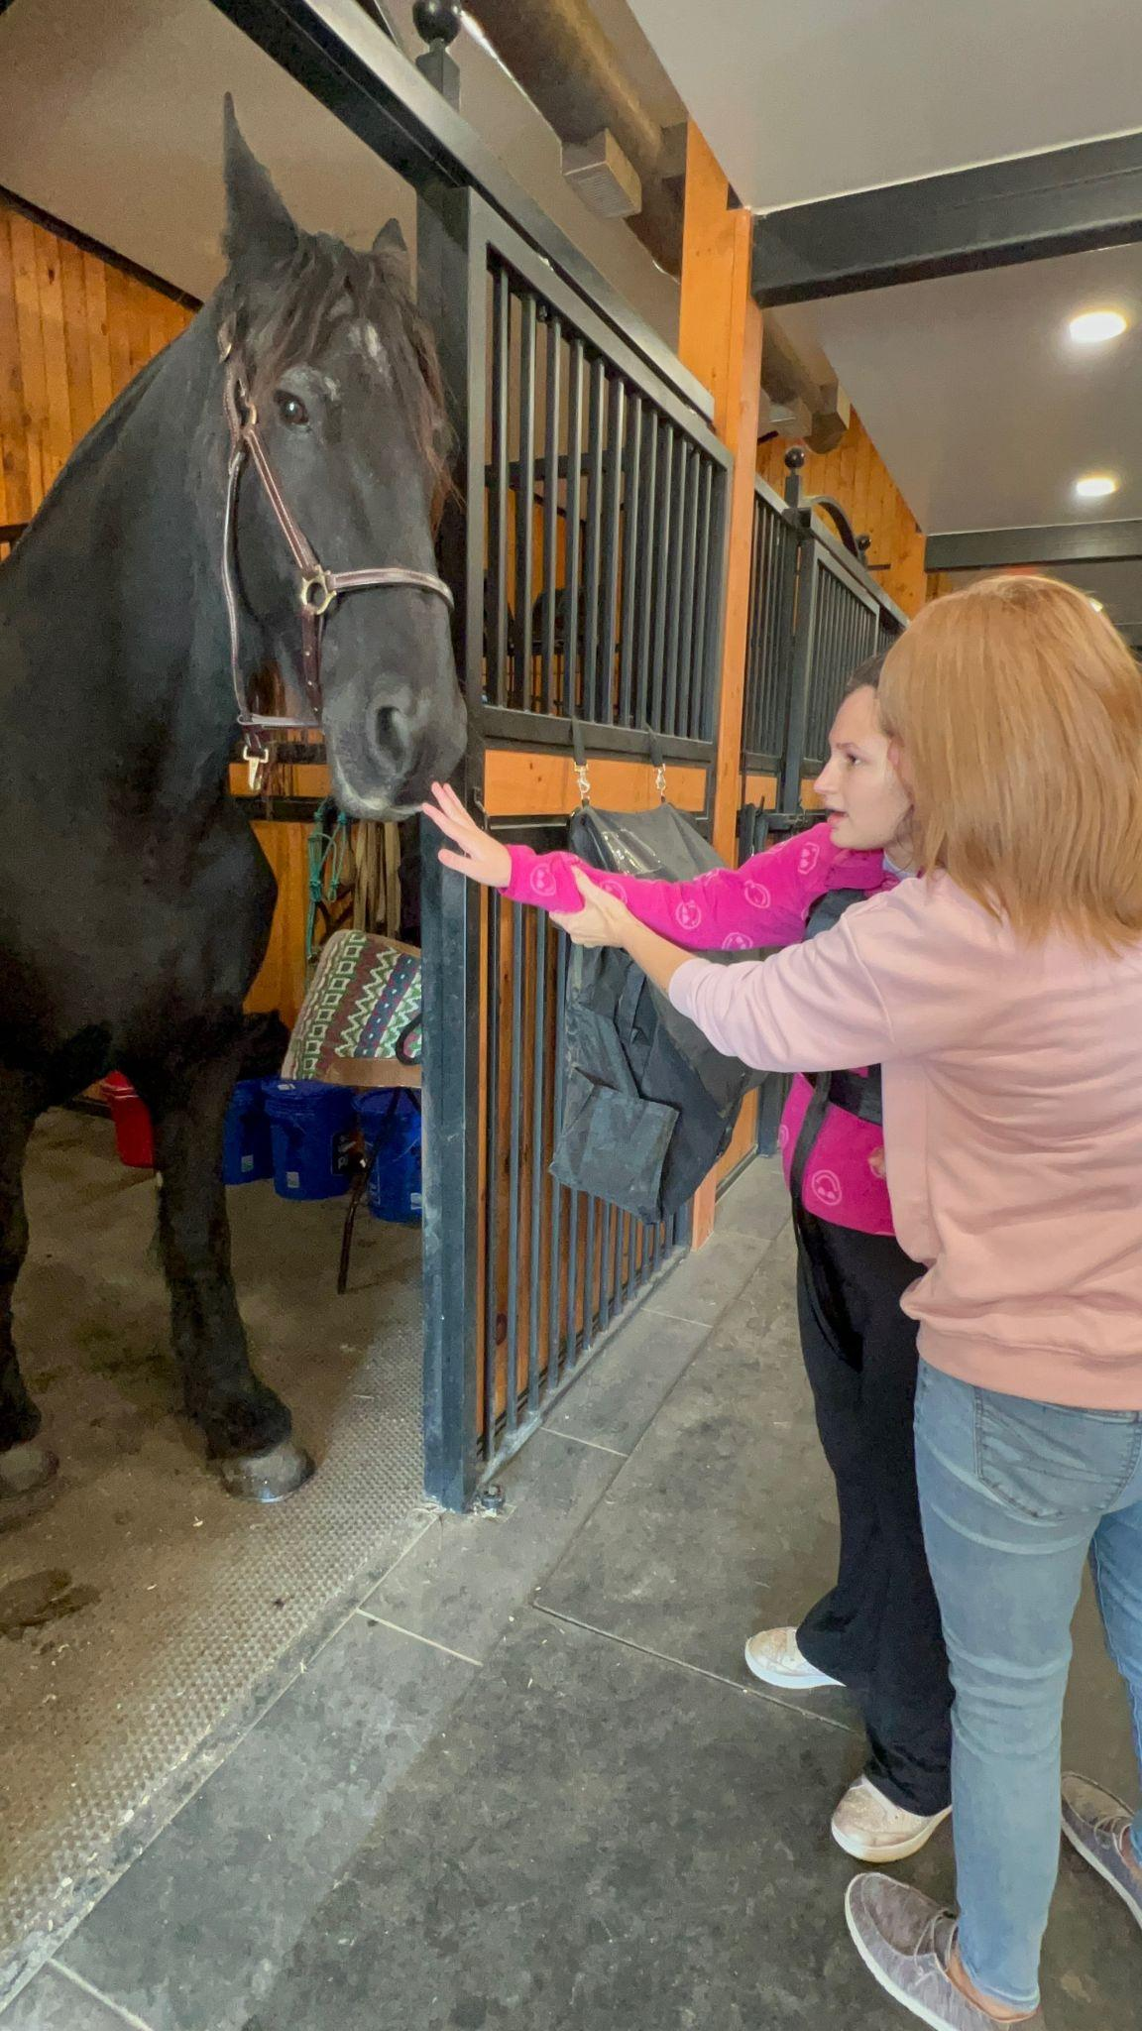
Community WBL
Experiences

Slide 27
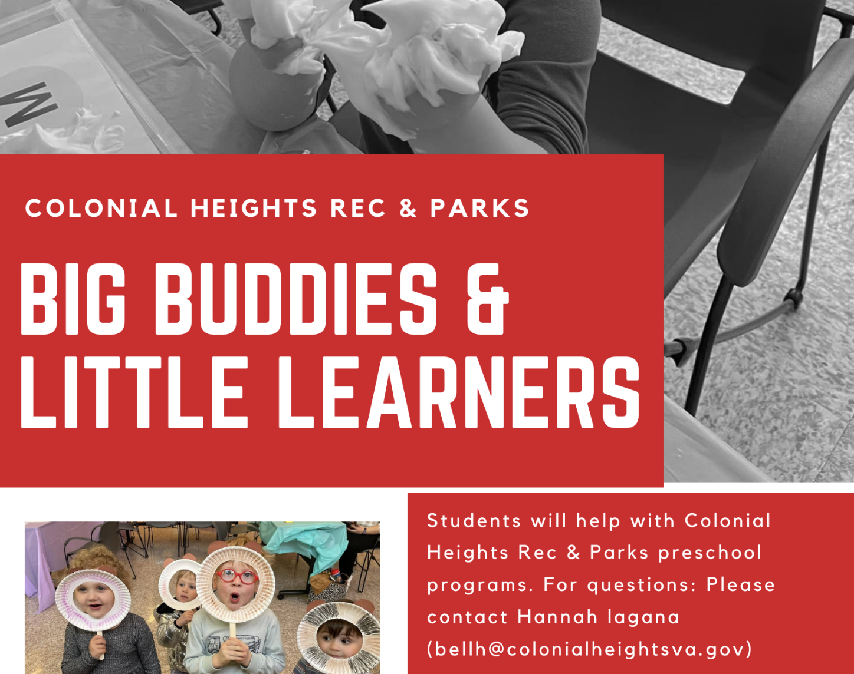
Colonial Heights Parks and Recreation Department
Partial program already in place. We jumped in and added our students

Slide 28
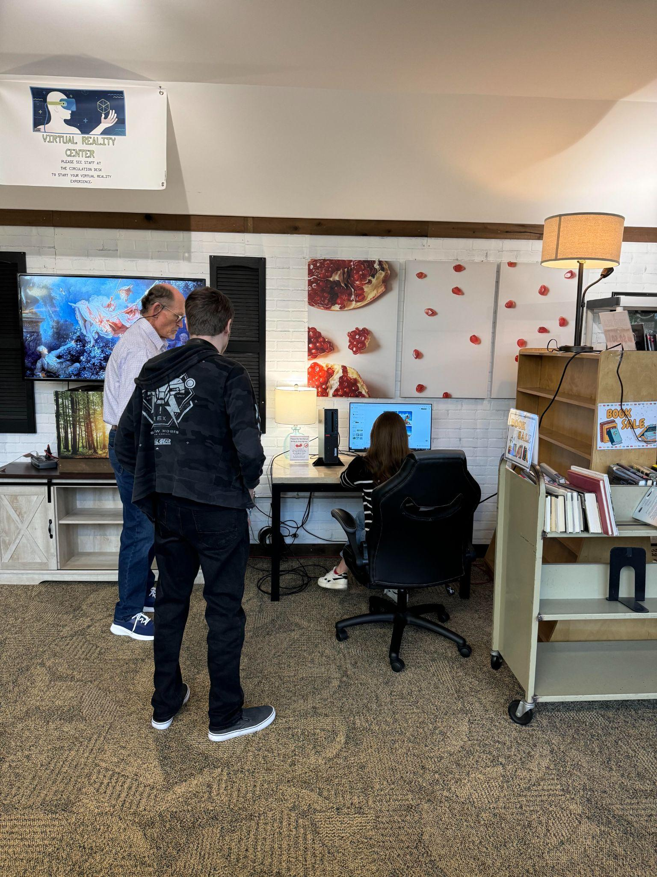
Colonial Heights Public Library
Partial program already in place. Colonial Heights Library employs CHPS students during and after their school careers. All were honors students with no exceptionalities
We needed to get them to consider working with one of ours
Program was limited simply by size of library

Slide 29
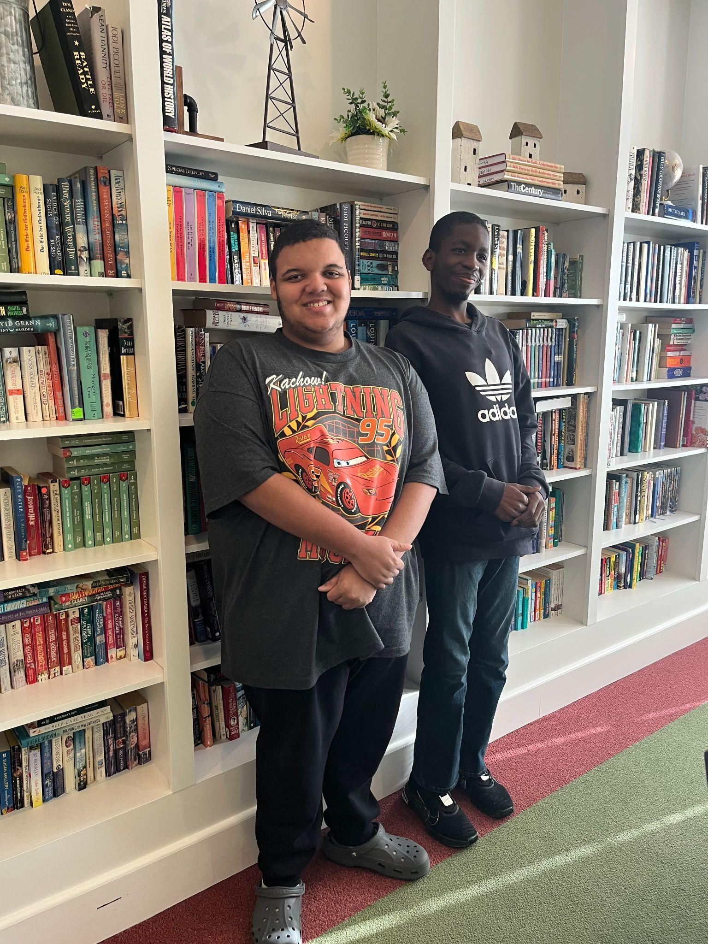
Dunlop House Assisted Living and Memory Care
Had hosted students for volunteer hours for years
Close proximity to school (.5 mile)
Many school alumni currently work there
Challenges
Normally doesn’t host during the day
Had never worked with functional academics population
Unsure who would have final authority/permission to approve

Slide 30
Kelmarbi Farms
Began as we looked at programs to see if therapeutic horseback riding could fit into our program
Expanded into a search for vocational opportunity that placed students outdoors and around animals
Challenges
Not a lot of farms near us
Finding the right people to contact. Many agricultural/animal related businesses aren’t made for public contact
Insurance

Slide 31
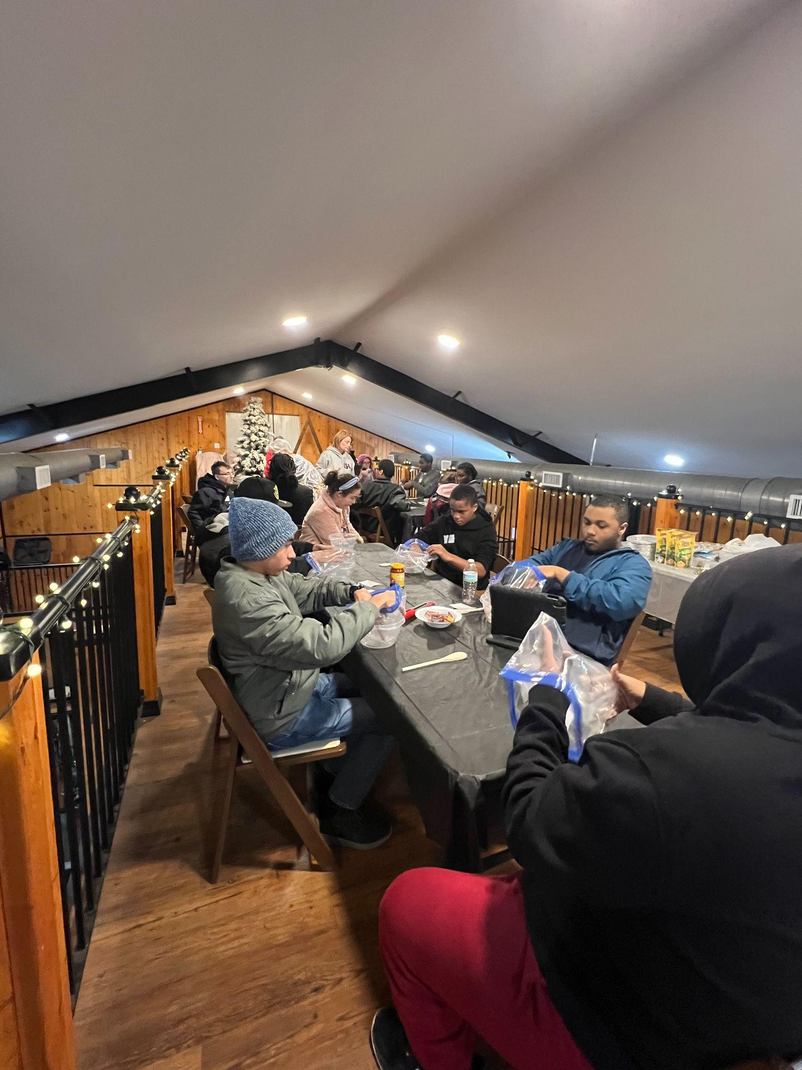
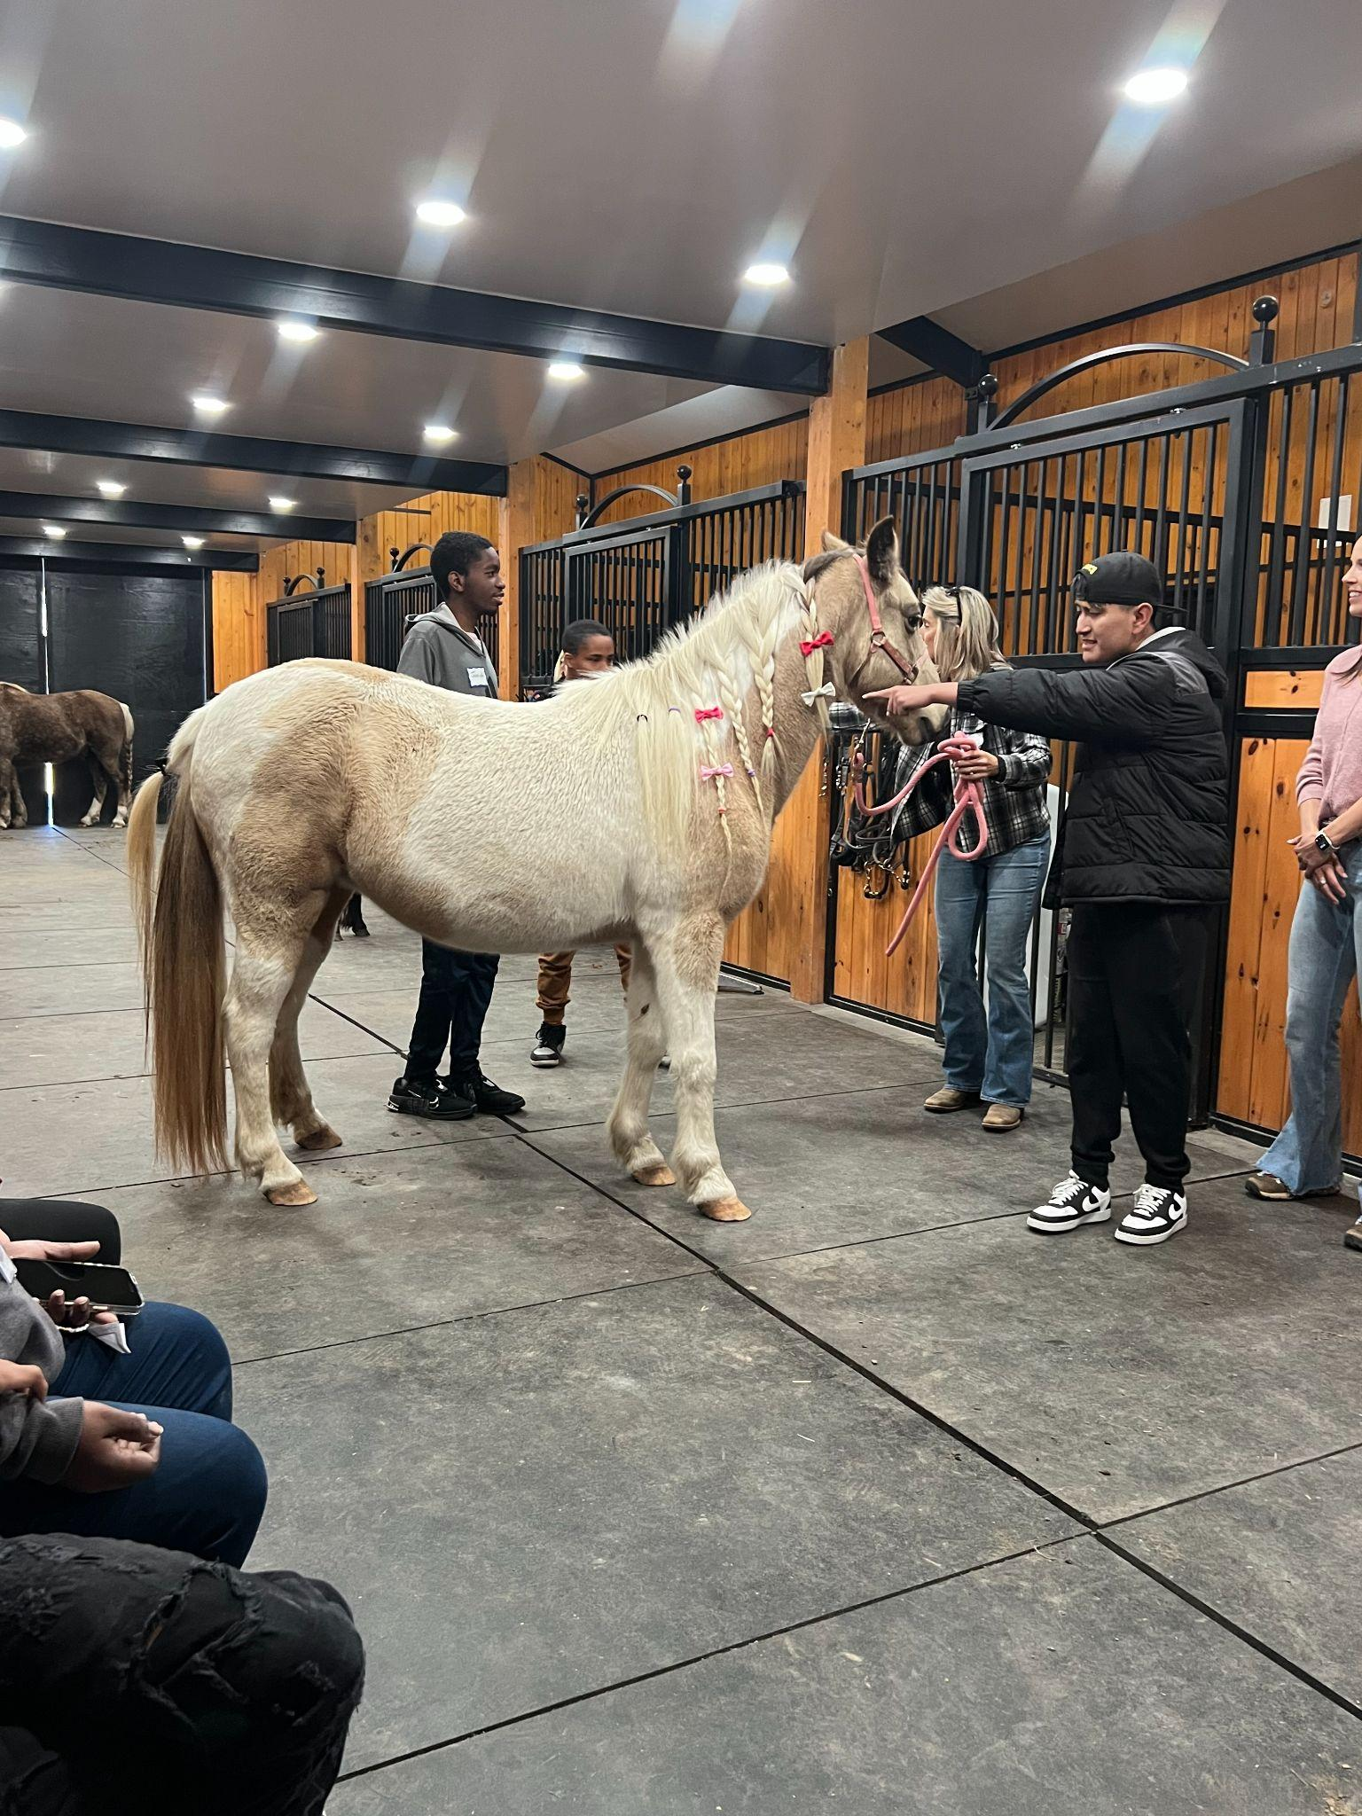
Kelmarbi Farms

Slide 32
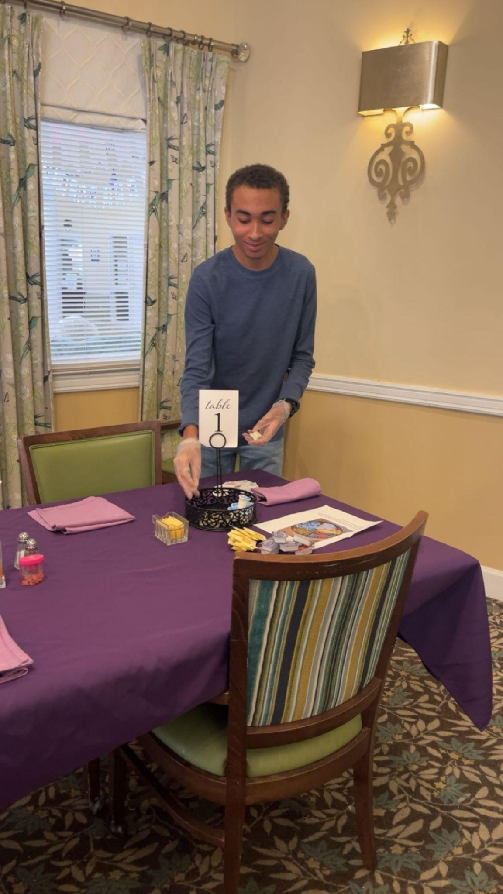
Recommended Strategies
Planning, public communication and evaluation should proceed simultaneously
Find “friends” within the district
  Parent Resource Coordinator
  Interpreter
Find low cost/no cost experiences
Figure out how to work transportation
Keep talking to people! Opportunities happen at the unlikeliest of times

Slide 33
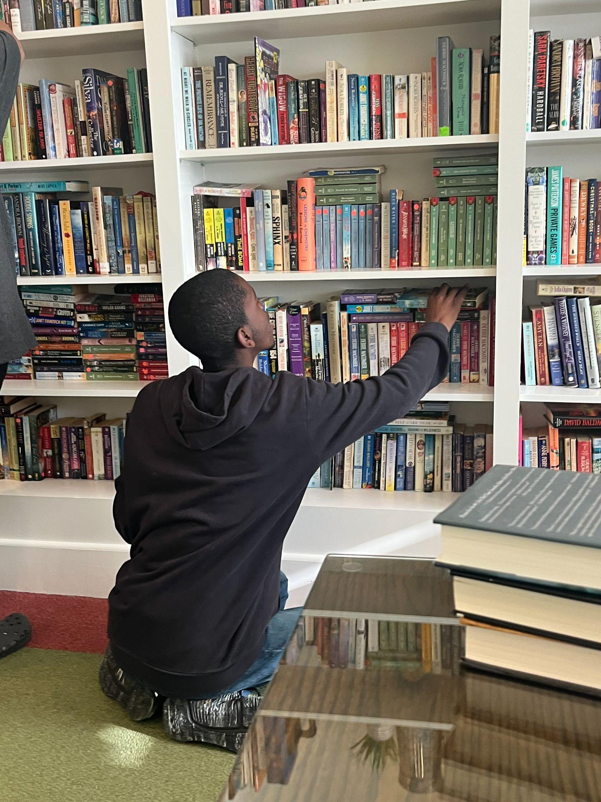
Lessons Learned
Takes time to develop networks & build relationships
Being embedded in communities
Community builders
Some things develop over time
Some happen quickly
Don’t be afraid to get something small started

Slide 34
Employment Outcomes: Next Steps and Goals
Photovoice
Transition plans and folders
DARS EPIC grant
Middle school!- CTI Training involving MS, Elementary and Paraprofessionals
Employment in home, school and community

Slide 35

Plan and Do!
Additional considerations
Administrative vs School Board Approval
Small asks and quick approval vs. bigger asks and longer-term planning

Slide 36
Questions

Slide 37


Slide 38

Incentives for Inclusive School!
Apply for Inclusion Project Incentives to create activities and events in your schools that advance disability awareness and inclusion.

Slide 39
Contacts
Daniel Pulskamp
daniel_pulskamp@colonialhts.net
Seb Prohn
smprohn@vcu.edu

