Slide 1

Employment Supports & Services: IEP Development
Chris Martin, Director, Employment Services Lisa Coates, Director, Youth Services
Monday, July 25th

Slide 2

Transition is process

Slide 3


Better Post-Secondary Outcomes
Complaint and Quality IEP/Transition Plans
=
Appropriate Transition Services
=
Better Post-School Outcomes
Gaumer-Erickson et al., 2014, Grigal, Test, Battie, & Wood, 1997, Landmark & Zhang, 2012; Mazzotti, Rowe, Cameti, Test & Morningstar, 2013; Test, et. al 2009

Slide 4

What does the Data Tell Us about Postsecondary Planning?
Students with significant support needs- not expected to attend college; <10% achieve competitive employment.
Post high school expectations - stereotypical jobs at sub-minimum wages - sheltered employment.
U.S. Department of Education, 2004; Wills & Leucking, 2003; Cameto, et al., 2004; Inge & Moon, 2006)

Slide 5

What Do Students with Disabilities Need?
The Transition from school to postsecondary, employment and community living is challenging for many students, this is particularly true for students who experience disability and even truer yet for students who experience significant disabilities.
All students, regardless of disability, need access to a high-quality education, exposure to the world of work including the chance to participate in work experiences, opportunities to develop leadership and advocacy skills, connections to caring adults, safe places they can interact with their peers, and access to support services and accommodations that can allow them to transition from youth to adulthood. (NCWD-Youth, Guideposts for Success)

Slide 6
What Do Students with Disabilities Need? -2
In addition to what all students need, students with disabilities need access to quality transition planning, inclusive of work exposure and experience that aligns itself with the interests, preferences, skills and support needs of the student.
Competitive Integrated Employment (CIE), real work for real pay is the gold standard of transition outcomes for students with disabilities. (National Technical Assistance Center on Transition (2017). Competitive Integrated Employment Toolkit, 2017.

Slide 7

Strengths Based
Reframe perceptions of students with significant disabilities
Focus on preferences and what a person can do, not what they can’t
Shifts emphasis to adding value, not what needs to be fixed
Able to target employment settings where job seeker’s unique characteristics and skills will be assets - where they will fit in and make friends

Slide 8
IDEA
The purposes of IDEA include ensuring that all children with disabilities have available to them a free appropriate public education (FAPE) that emphasizes special education and related services designed to meet their unique needs AND
prepare them for further education, employment and independent living.
[34 CFR 300.1(a)] [20 U.S.C. 1400(d)(1)(A)]

Slide 9

It’s Never too Early to Start Planning!
Transition planning needs to start early and continue over time for youth with disabilities.
It’s never too early to start planning.

Slide 10

Transition Services
Transition services means a coordinated set of activities for a child with a disability that—
is designed to be within a results-oriented process, that is focused on improving the academic and functional achievement of the child with a disability to facilitate the child’s movement from school to post-school activities, including postsecondary education, vocational education, integrated employment (including supported employment), continuing and adult education, adult services, independent living, or community participation.

Slide 11

Importance of Self-Determination
Starting with the 1990 reauthorization of the Individuals with Disabilities Education Act (IDEA) (P.L. 101-476), transition services must be based on student needs and consider student interests and preferences
Self-determined students have a stronger chance of being successful in making the transition to adulthood, including employment and independence (Wehmeyer & Schwartz, 1997)

Slide 12







Self-Determination & Student Input
Make choices
Set goals, make plans to achieve goals
Attend the IEP meeting
Actively participate in the transition planning process
Lead the IEP meeting
Learn and practice self-determination skills

Slide 13
Transition Requirements
Student input (invited to meeting and preferences and interests considered)
Outside agency participation
Age-appropriate transition assessments
Postsecondary goals based upon transition assessments
Annual transition goals
Transition services/
Coordinated Activities
Courses of study

Slide 14

Student and Agency Participation
IEP teams must:
  Invite the student to the IEP meeting;
  Ensure that the child's preferences and interests are considered, if they do not attend
  Invite a representative of any participating agency that is likely to be responsible for providing or paying for transition services with the prior consent of the parent or student who has reached the age of majority.

Slide 15

Transition: A Collaborative Student-Led Process
Ideally, Transition planning for students with disabilities is led by the student and is a collaborative effort between the local education agency, vocational rehabilitation, the student’s family or natural support system with a focus on Competitive Integrated Employment.

Slide 16

Present Levels
The Present Levels of Academic Achievement and Functional Performance (PLAAFP) describe the level at which students are working academically and functionally.
Transition Assessment results must be documented in the IEP in the PLAAFP.
The IEP team will utilize the data results to develop goals and services.

Slide 17
Transition Assessment
Transition Assessment is an ongoing process of collecting data on the student’s “SPIN”
  Strengths
  Preferences
  Interests
  Needs (which become the annual goals).

Slide 18

Areas to Address
Employment
Education/Training
Independent Living
Community Participation

Slide 19

Post-Secondary Goals
Must occur AFTER high school and must be updated annually!
Postsecondary Goal Areas:
  Education/Training
  Employment
  Independent Living (if appropriate)
  Community Participation (if appropriate)

Slide 20

Measurable Post-Secondary Goals
Postsecondary Goals are measurable if they answer the following questions:
  Where will I LEARN after high school?
  Where will I WORK after high school?
  Where will I LIVE after high school?
  How will I PARTICIPATE in the COMMUNITY after high school?

Slide 21

How to Develop Post Secondary Goals
Base them on student’s strengths, preferences, and interests from the assessment results
Use a career interest inventory for the Education/Training and Employment Postsecondary Goals
Get input from student and family

Slide 22
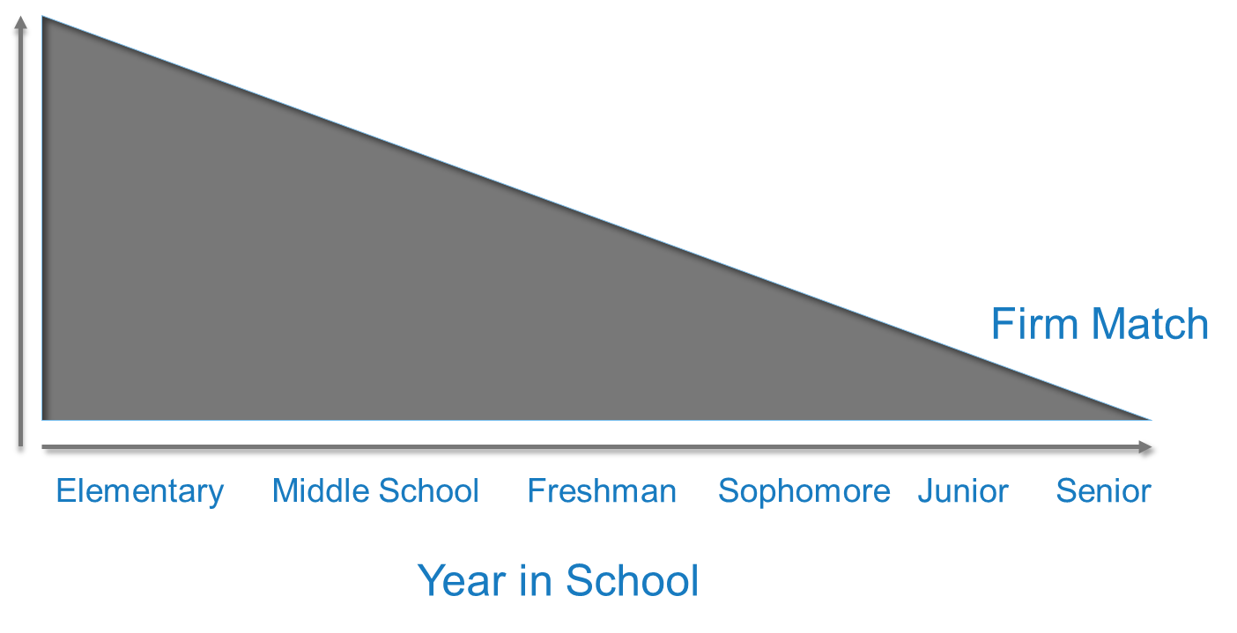
Post-Secondary Goal Fluff Scale
Match Not as Important (Fluff OK)

Slide 23

Postsecondary Employment Options
How often?
Part time/Full Time
What type?
Competitive, volunteer, entrepreneurial, community integration/participation
Career Type?
Area of interest, based upon preferences
Supports Needed?
Vocational Rehab, Job Coach, Paid Co-Worker, Assistive Technology
Location?
Where?

Slide 24


Think and Share
1. Who can help you determine the best course of study for students?
2. What tips can you share with the group about creating a course of study for students with significant support needs?

Slide 25
Upper Elementary and Middle School-Grade 5-8
Focus
  Career Exploration and transition planning relative to course of study; independent living (ADLs)
Needs
1. Understand relationship of school to work
2. Understand interests, preferences, aptitudes.
3. Understand work, education, independent living, and community options.
4. Determine a general course of secondary study.
5. Identify needed accommodations and supports for secondary education.
6. Specify transition services needed to participate in desired course of study.

Slide 26
High School
Grade 9-10
Focus
  Career exploration and transition.
Needs
  Develop meaningful and realistic postsecondary goals.
  Develop work, education, residential, and community participation skills and supports relevant to goals.
  Learn to manage disability technology and request accommodations.

Slide 27
High School
Grades 11 and Up
Focus
  Transition and overlap into postsecondary environments desired by the student.
  Needs
Test goals through experiences and activities.
Secure options for postsecondary education and/or employment.
Develop residential and community participation supports and contacts.
Develop linkages with adult services
Empower families to function in adult service environments.

Slide 28

Case Study
Transition Content Academy Padlet

Slide 29
Leveraging Connections
Chris Martin, Director, Employment Services Lisa Coates, Director, Youth Services
Tuesday , July 26th

Slide 30
Transition Interest Inventories and
Exploration Tools
Career Interest Inventories
Exploration tools
  Career Interest Inventory-Pictorial
  P-CAET
  My Next Move (O*Net)*
  O*Net
  Career One Stop
    Career Videos
These provide students with an idea of how their interests and preferences align with jobs and guide education postsecondary goals.
Notes:
Using the interest inventories and other exploration tools, students can create their postsecondary goals.

Slide 31

Transition Skills and Abilities Assessments
Transition skill assessments identify strengths, needs, and abilities.
These assessments are crucial when developing appropriate annual transition goals.
Use the needs identified in the transition assessments to build the annual transition goals.
Notes:
Transition skill assessments identify strengths, needs, and abilities.
These assessments are crucial when developing appropriate annual transition goals.
Use the needs identified in the transition assessments to build the next step—annual transition goals.

Slide 32
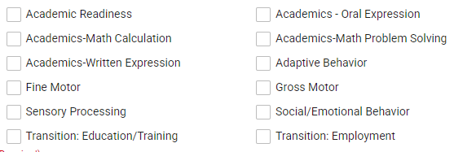
Areas of Need that May Impact Transition

Slide 33
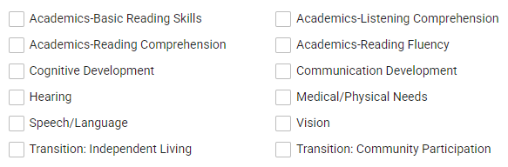
Potential Areas of Need that May Impact Transition - 2

Slide 34
Adaptive Behavior Examples
Communication (Receptive, Expressive, and Written)
Behavior
Health & Safety
Home Living
Work Skills
Vocational Training
Motor Skills (Gross and Fine)
Daily Living Skills
Self-Direction
Self-Care
Functional Academics
Leisure/Recreation
Relationships
Social Skills
Transportation/Mobility

Slide 35

HQWBL experiences reinforce Virginia’s 5 C’s—critical thinking, collaboration, communication, creative thinking, and citizenship—by allowing students to apply these skills in a real-world business or service-oriented work environment.
Collaboration: Work with community members, peers, and mentors
Communication: Write and present proposals; make requests and get permissions; publicize and present final project
Citizenship: Understand laws and regulations; seek to improve the community; increase community awareness
Creativity: Publicize/advertise project; solve problems; present findings
Critical Thinking: Develop a project to meet a community need or solve a community problem

Slide 36

Work based Learning (WBL)
Job shadowing
Career Mentorships
Career Related Competitions
Informational Interviews
Paid internships
Non-paid internships
Practicum
Service Learning
Student Led Enterprises
Paid Work Experiences
Non-Paid Work Experiences
Volunteering
Work-place tours
Work-based learning experiences | WINTAC
Notes:
These WBL opportunities can be done in conjunction with private, for-profit, public or nonprofit businesses in your community and/or through web-based resources. In addition, work-based learning requires in-depth engagement of youth with oversight and evaluation of acquired work relevant skills by identified staff. The work-based learning experience must be provided in an integrated setting in the community. Where paid WBL experiences are provided, the wages are to be paid at no less than minimum wage.

Slide 37

Business Engagement &
Employer Supports
Business Engagement and Employer Supports | WINTAC

Slide 38




Networking With Businesses & Community Resources
A Guide to Networking With Businesses (centerontransition.org)
Providing Jobsite Supports (centerontransition.org)
Community Resource Mapping (centerontransition.org)
download.cfm (centerontransition.org)

Slide 39

Wrap-up
How will this information help you to develop better secondary transition plans?
What questions do you still have about secondary transition planning?

Slide 40
Resources
National Technical Assistance Center on Transition the Collaborative (NTACT:C)
OSERS: A Transition Guide to Postsecondary Education and Employment for Students and Youth with Disabilities
PACER’s National Parent Center on Transition and Employment

Slide 41

Thank you.
To learn more, visit SOAR365.org

