Slide 1
Using Art and Technology to Leverage Work-Based Learning Experiences for Students with Disabilities
Molly L. Taylor, LaNeka Brown, Tammy Sellers, Amanda Dailey, Seb Prohn, & Richard Chapman

Slide 2
TABLE OF CONTENTS
01
02
03
04
Project PEACE Overview
Photovoice
Digital Portfolios
Virtual Asset Mapping

Slide 3
What is Project PEACE?
Promoting Employment After high school through Community Experience
Community-based capacity building project designed to increase the employment of persons with IDD
Grounded in the lived experiences of community members
Project PEACE was supported in part by grant number 90DNCE0004-01-00, from the U.S. Administration for Community Living, Department of Health and Human Services, Washington, D.C. 20201.

Slide 4
Our Approach to Work-Based Learning
Asset Mapping
Photovoice
Portfolios

Slide 5
Photovoice: A Powerful Research Tool
Exploration
Students explore their own preferences, needs, and experiences, while also exploring careers.
Self-Advocacy
Students learn to communicate their preferences, needs, and experiences.
Data Collection
Researchers, teachers, families, and admin can learn more about their students and their transition assets and needs.

Slide 6
Our Photovoice Project
3 Intensive Support Classrooms in RPS High Schools
5, 1-hour sessions over the course of 4 weeks
Allowed for student engagement that fit into the class structure
First 3 sessions: photography, communication, and respect skills building
Built-in WBL experiences
Last 2 sessions: student discussions about their photos
We asked students:
What are your employment goals?
What are your employment barriers?

Slide 7

Let’s look at some student photos!

Slide 8
Digital Portfolios
Leveraging photovoice to create a transition & employment tool
Google Classroom & Google Sites

Slide 9
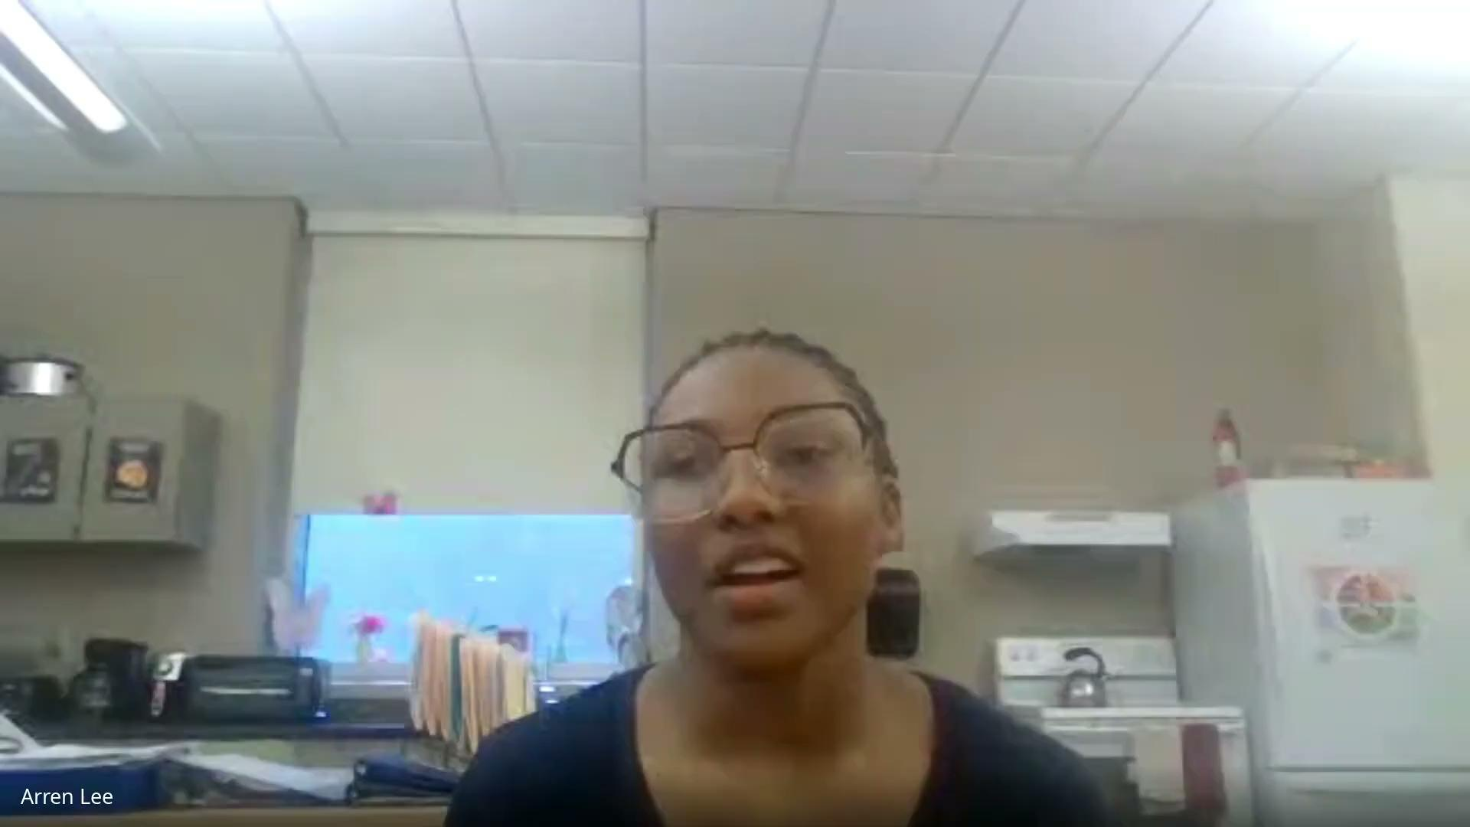
Student Portfolios!

Slide 10
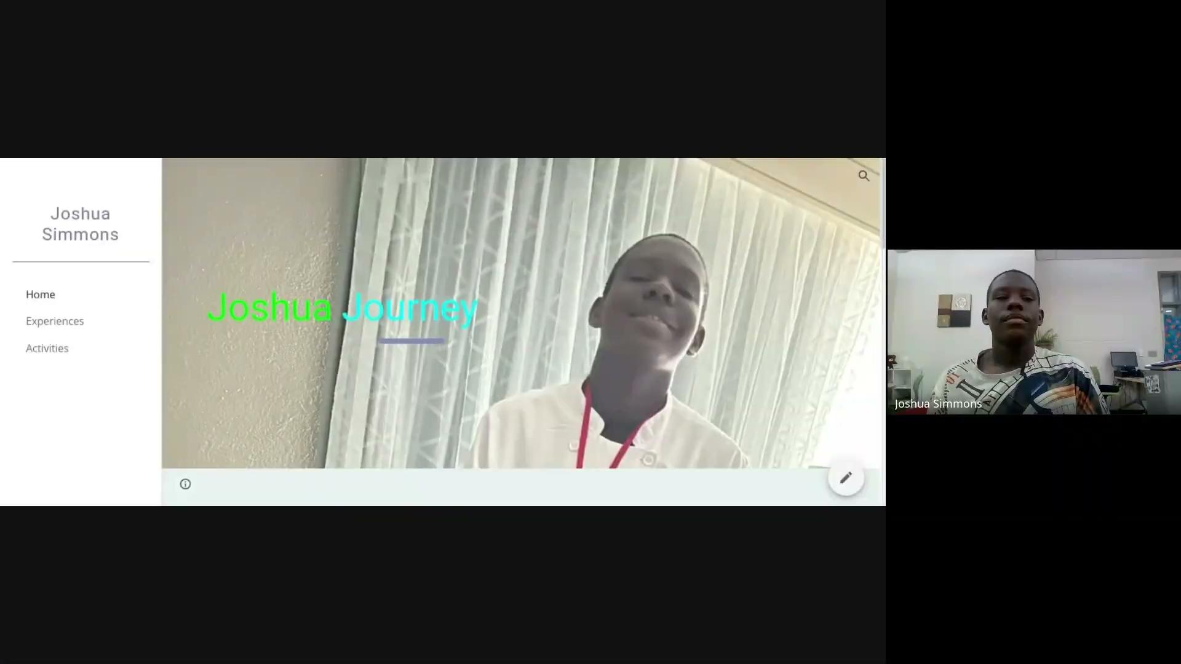
Student Portfolios!

Slide 11
What can we do with portfolios?
Student-led IEP meetings
Interviews
Custom websites
Easy networking
Direct connections to photovoice and asset mapping

Slide 12
Virtual Asset Mapping
Community connections:opportunities, services, supports, etc– predict post-school success
We can foster collaboration–but we’ve got to be aware of resources!
Mapping can help!
Use maps to identify resources to address a pressing need. All communities have assets!

Slide 13
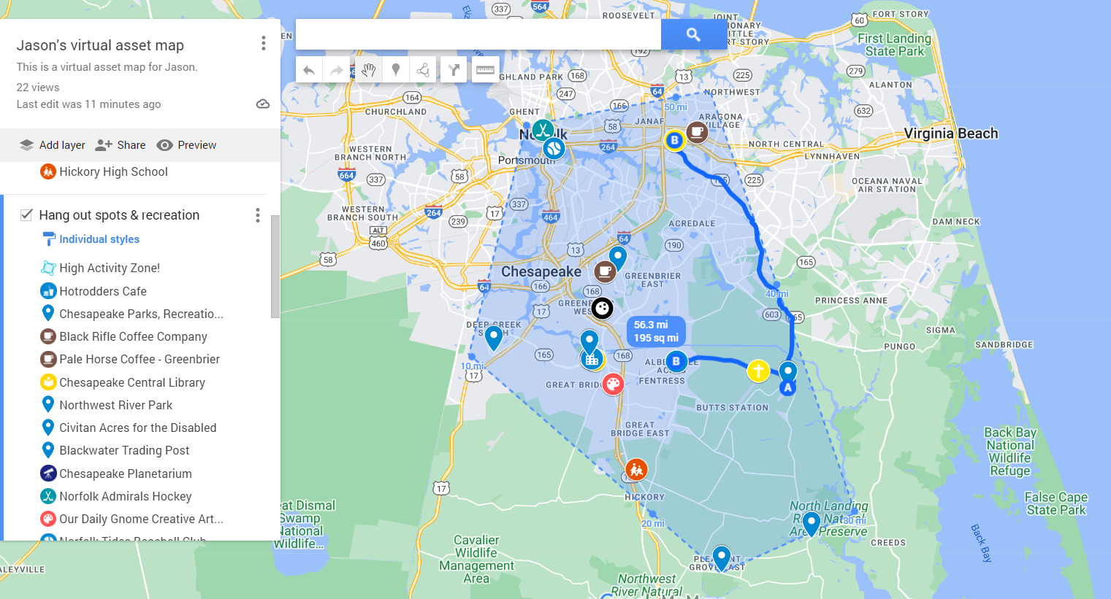
Example: Areas student can reliably travel

Slide 14
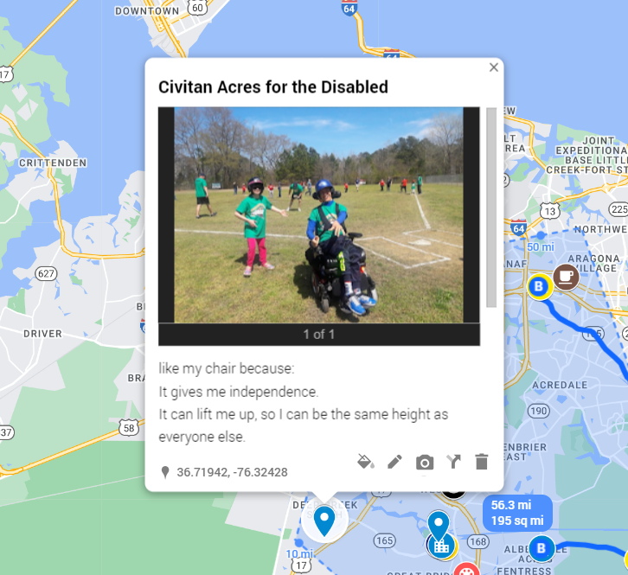
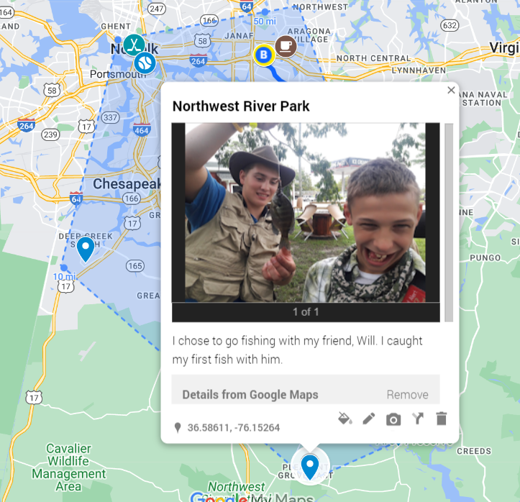
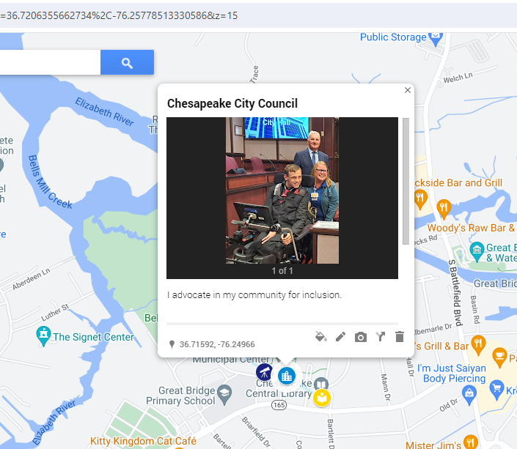
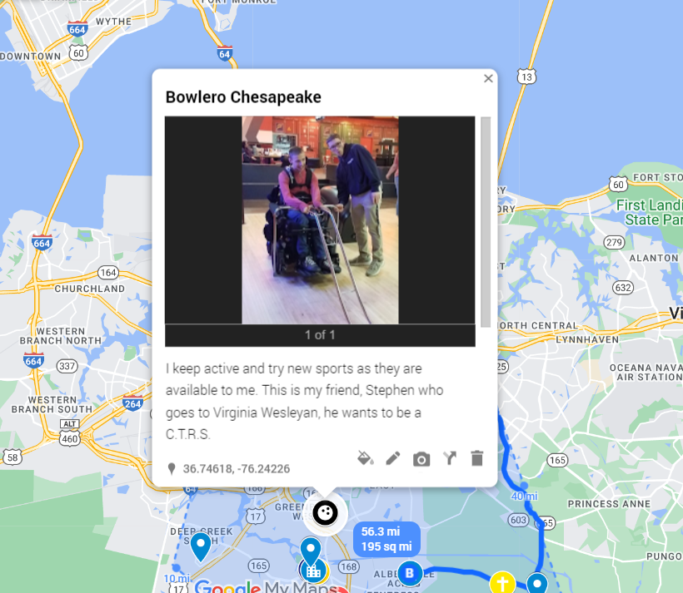
Student Personalization

Slide 15
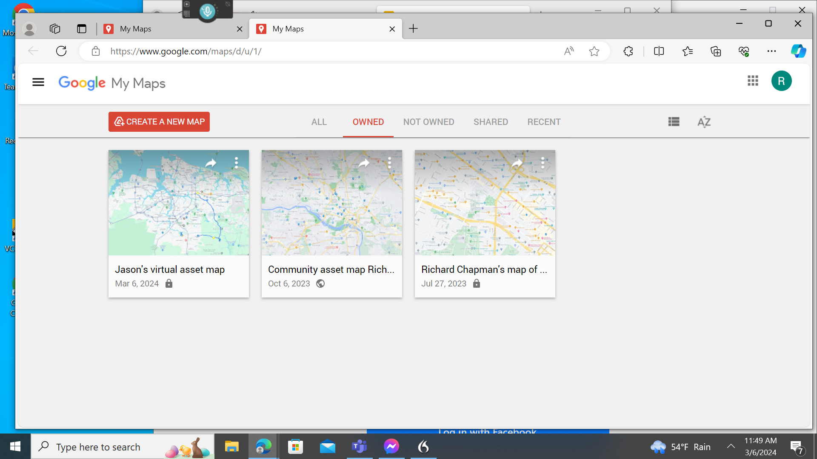
Let’s Try It Out!
Google My Maps Homepage

Slide 16
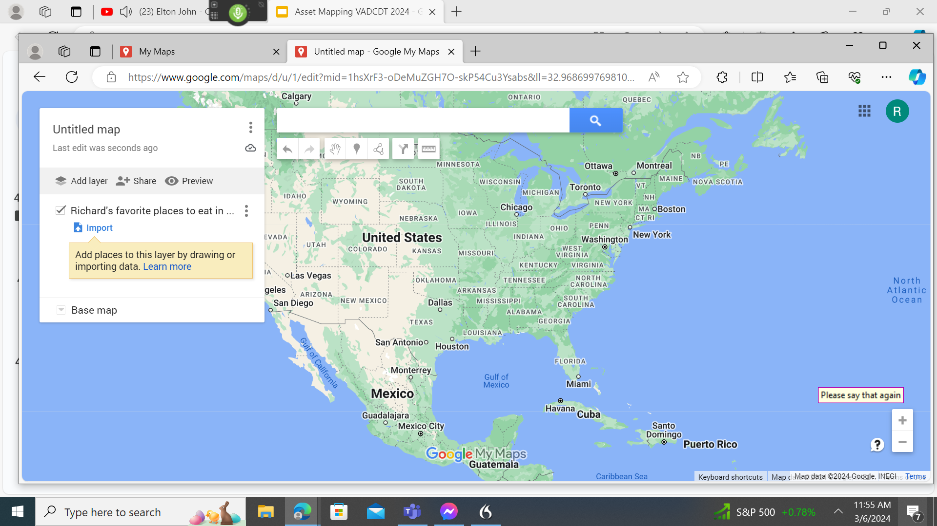
Add a layer to the page

Slide 17
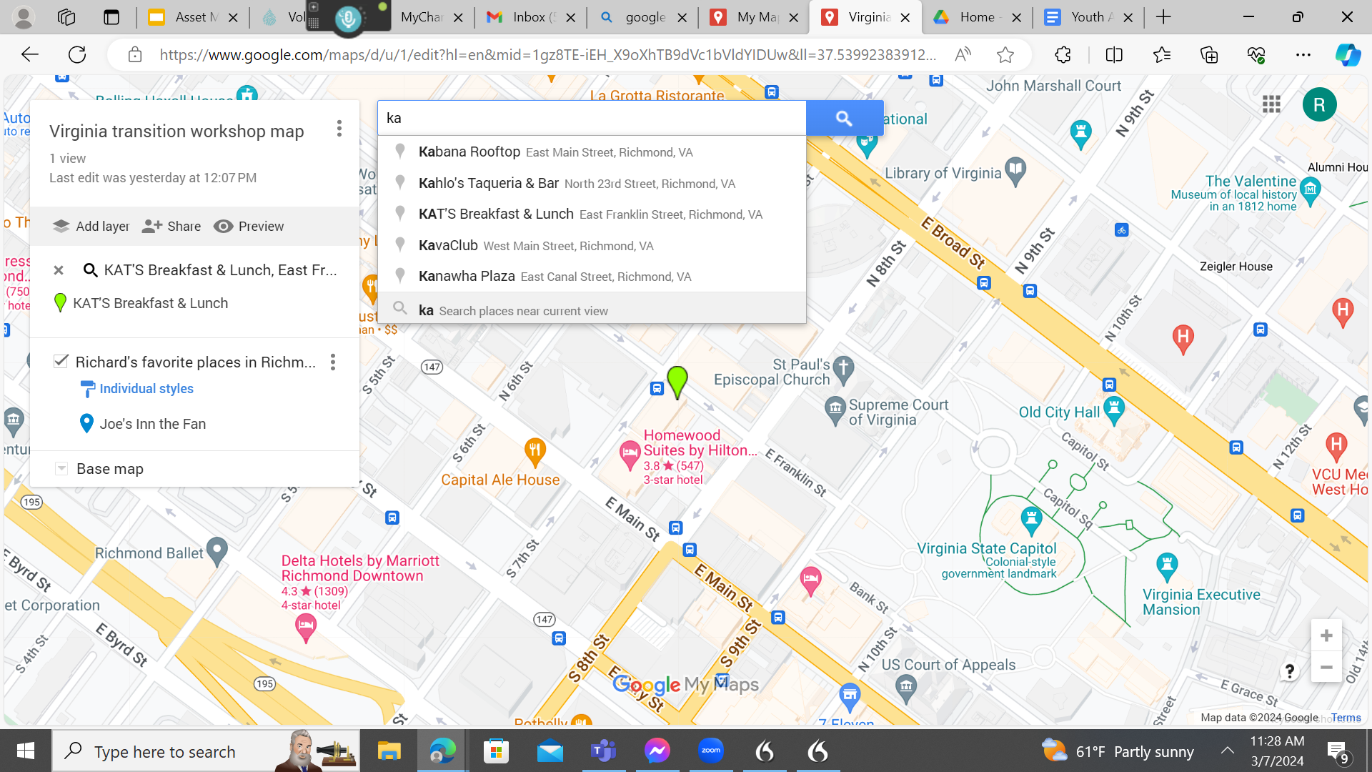
Add a resource to the map

Slide 18
RESOURCES AVAILABLE TO YOU
Photovoice Implementation Guide
On Their Way:
Digital portfolios implementation guide
Virtual asset mapping implementation guide
https://drive.google.com/file/d/121whttps://drive.google.com/file/d/121wenf46HqNhuLS4UHdo7MxFYAh8MdYU/view?usp=drive_linkenf46HqNhuLS4UHdo7MxFYAh8MdYU/view?usp=drive_link

Slide 19
Stay In Touch!
Contact Us:
projectpeace@vcu.edu
taylorml9@vcu.edu
Our Website:
https://partnership.vcu.edu/programs/community-living/project-peace-community-collaborations-for-employment/

