Slide 1

Project PEACE: Promoting Employment after high school through Community Expertise
Molly Taylor
Seb Prohn, Ph.D.
Partnership for People with Disabilities
Virginia Commonwealth University

Slide 2
This project was supported, in part by grant number 90DNCE0004-01-00, from the U.S. Administration for Community Living, Department of Health and Human Services, Washington, D.C. 20201.
Notes:
Project PEACE was supported by the US Administration for Community Living.

Slide 3
What is Project PEACE?
Promoting Employment After high school through Community Expertise
Our Values
Leading our research are people of color and people with disabilities
Rooting conversations in lived experiences of our community members
Notes:
Over the last year, Project PEACE has worked to conduct a Community Landscape Analysis with the intention of better understanding barriers to transition and employment for youth with intellectual and developmental disabilities and employment solutions that are unique to our community. Our goal is to create a model that other communities can adopt and then use to assess their own area’s needs and assets related to employment for youth with IDD. We conducted this analysis with two core values, one being that the people we’re serving will be represented on our research team which is why we have people of color and people with disabilities as leaders on our Project PEACE team. We also intend to center our research in the lived experiences of youth with IDD, their families, and other stakeholders in the community. Essentially, we treated this community landscape analysis as an opportunity to actually listen to what the members of our community want and need when it comes to improving transition and employment outcomes.

Slide 4
Our Approach to Community Collaborations for Employment
Multi-method Research Approach
Understanding Community Contexts
Notes:
So to get into our research methods, we took a multi-methods research approach to our community collaborations and community landscape analysis and this allowed us to understand employment barriers and solutions relevant to the context of a given community.

Slide 5
Research Methods
Secondary Data Review and Analysis
Business needs assessment survey
Community Conversations
Photovoice
Notes:
Our research methods include a review and analysis of secondary data and reports on employment for people with IDD. We also collaborated with the Metropolitan Business League in Richmond to conduct a business needs assessment which gave us insight into the kinds of supports employers might need to hire youth with IDD. And then, we conducted a series of community conversations to hear from various stakeholders about their transition/employment recommendations. And finally, we conducted a photovoice project with youth with IDD to have them share their feelings about employment through photographs. Today, we’ll go over our secondary data review, community conversations, and photovoice in more detail.

Slide 6

Secondary Data Review & Analysis
1. Reach out to research and community partners for documents, reports, and papers
Strategies for finding sources
2. Look in unexpected places (school division websites, appendices in other reports, ect…)
Notes:
To get started, I’ll go over the objectives of our secondary data analysis and review. Our goal was to create a living document with transition and employment assets in Virginia and in the city of Richmond, as well as a synthesis of previous data reports on employment nationally and in Virginia, and to give a review of Project PEACE’s research efforts. I’ll quickly give some strategies we used to find sources for this review, the first of which is to reach out to community partners for any reports or documents on employment and transition that exist but may be hard to find on public sites. We also recommend looking in unexpected places like the department of education website, school division websites, the appendices of other reports and documents, and more to dive into what others have found regarding transition and employment and this process gave us a better idea of assets and barriers to employment in our own community that we then compared with what we were hearing from stakeholders.

Slide 7
Community Conversations
Method
  Recruitment
    Who do you invite?
  Session structure
    2 breakout sessions, whole group harvest
Notes:
So now for the community-engaged research. As I said earlier, hearing from community members is a big objective of Project PEACE, and so we held three Community Conversations with any and all employment and transition stakeholders in our community. As far as recruitment goes, we invited educators from our local school division, transition specialists, service providers, agency and organization representatives (for example, we invited representatives from Virginia’s Vocational Rehabilitation agency (DARS)), business owners and employers, and of course, youth with IDD and their families. And of course the groups of people you invite is going to vary for different research projects and aims. All of our sessions thus far have been virtual due for participants’ safety, time, and transportation concerns, although in your community in-person sessions may work better.
So far, we have conducted two community conversations sessions, and we begin each one hearing the story of a young person with IDD or a family member of a young person with IDD and that really grounds the conversation so that participants understand the importance of our work and the importance of their attendance at these sessions. After the introduction, we get into our breakout sessions and this usually consists of two to three breakout groups, depending on the number of participants you have, and we put these breakout groups together beforehand to be sure that there were a mixture of roles present in each group so that different perspectives and voices were heard. We also have one to two facilitators for the breakout sessions who are project team members and they steer the conversation so that the group stays focused on solutions to improving transition and employment rather than only focusing on barriers.

Slide 8
“I really enjoyed this morning, how we opened up the session with individuals telling their story”
Notes:
Here is a quote from one of our participants that says “I really enjoyed this morning, how we opened up the session with individuals telling their story”, and this speaks to how important it is to have youth with IDD tell their own transition and employment stories during these conversations.

Slide 9
Community Conversations: Preliminary Results
Barriers to Employment
Solutions for Employment
Changing attitudes/mindsets
Accessibility
Lack of Resources
Supporting Youth
Supporting Employers
Attitudes/Mindsets
Using Technology
Supporting Educators
Notes:
Okay so now here are some results from our first session. We first deductively created two code groups that we would use to code conversation transcripts. The first is barriers to employment and the second is solutions for employment. Below those two code groups, you can see the main codes that were created so for barriers we have accessibility, lack of resources, and attitudes and mindsets. Under solutions you see changing attitudes and mindsets, supporting youth, supporting employers, supporting educators and using technology.

Slide 10
Subcodes
Supporting Employers
Education
Partnerships/
Relationships
Mentorship
Notes:
So under those main codes, we created subcodes so for an example, we have supporting employers. Under supporting employers, we have solutions including education, partnerships and relationships, and mentorship.

Slide 11
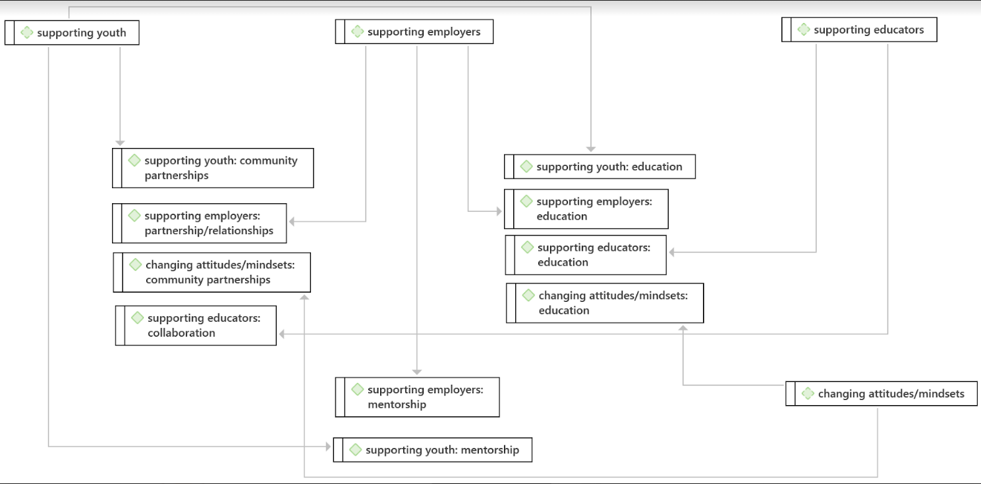
Network Map
Notes:
Using Atlas.ti, we created a network map with codes and subcodes and the connections between them. As you can see, under supporting youth, supporting employers, and supporting educators, we see common subcodes of partnership, mentorship, and education. These subcodes also relate to changing attitudes and mindsets. From this map, you can see that the underlying themes grounded in the dialogue are things like educating stakeholders, collaboration between agencies, educators, and employers, and mentoring employers and youth.

Slide 12
Photovoice
Method
  Recruitment
    How do you get youth to participate?
  Session structure
    6 sessions
Challenges
  Recruitment
  Engagement
Notes:
Now we’ll get into photovoice, which is a research effort that is currently underway. Photovoice is a method that has participants take photos of things they believe represent how they feel or perceive a given phenomenon, and in this case we asked participants to take photos related to their employment and transition experiences. The participants then come together as a group, and discuss what the photos mean to them.
As far as recruitment goes, we really struggled with this and it’s noted here as a challenge because at the beginning of the project, we lacked a trusting relationship with youth with IDD in our community. We ended up reaching out to a community partner to talk to youth about the project and they helped us connect with youth to recruit them. We also believe it’s important to show youth and their families how participation can benefit them and how the project has ongoing efforts to include the youth in these employment initiatives.
Engagement during the sessions is also important as they were conducted virtually, so having interactive sessions that constantly asked youth their thoughts and feelings on a topic was crucial to participant retention.

Slide 13
Photovoice Sessions
1
2
3
Registration Meeting
Answering Questions
Parental Consent
Project Overview
Consent Discussion
Telling Stories
Camera ethics
Taking a good storytelling picture
4
5
6
Small Group Discussion
~20 Minutes
Whole Group
Next Steps of Project
Taking quality pictures
SHOWeD Questions
Introduce Topic 1
Small Group Discussion
~20 Minutes
Introduce Topic 2
Notes:
So real quick, I’ll go over the layout of photovoice sessions that we used, although this layout is absolutely flexible to your community’s needs. First, we had a registration meeting with participants and their families where we answered questions about the project, about Project PEACE, and what exactly they would be doing, and this also went a long way toward creating trust with youth and their parents. Then, the first 3 sessions were spent teaching youth how to take pictures that told their story and how to talk about their photos in a meaningful way. The last two sessions are spent talking about the photos that youth send in relating to that week’s topic, so for us we had two topics: what are your employment goals and secondly what are your employment barriers.

Slide 14
Challenges to community-engaged research
Takeaways & Strategies
Researcher-Participant Trust
IRB/Timeframe
Creating your research team
Strengthening Community Partnerships
Centering the voices of youth with IDD
Notes:
So we thought we would give some challenges and strategies for conducting a community landscape analysis if you would like to use similar methods in your own communities. As I was talking about, researcher-participant trust is absolutely necessary for recruitment and retention efforts. No student or young adult is going to sign up if they don’t know you and they don’t know that your goal is to help them, and this can really be accomplished by strengthening those community partnerships. Second, is creating a research team that represents the community that you’re serving, that also has varying strengths and backgrounds. Finally, we suggest communicating with the IRB early, as working with such varying groups of stakeholders and working with minors can be somewhat complicated, especially if you want to include them as co-researchers. So it will take longer than you think to get IRB approval and to gain the community’s trust, but doing both of these things will propel your research forward when you get to collecting data. And finally, our biggest strategy is to continue centering the voices of youth with IDD and their families, as this is what stakeholders respond to most.

Slide 15
Feel free to reach out and follow along through these platforms:
Thank You!
@projectpeace@vcu.edu
@smprohn@vcu.edu
@taylorml9@vcu.edu
@ProjectPEACE_VA
@projectpeace_va

