Slide 1
Project PEACE:
Community Collaborative for Employment Transition
November 9, 2020
4:30 PM- 6:00 PM

Slide 2
Today’s Agenda
Welcome & Icebreaker
Spotlight Virginia: Student Success Video
Review of Community Conversations 2 & Landscape Analysis Theme
Year 2 Overview
Visioning
Evaluation
Closing

Slide 3


Ice Breaker!
What do you call a baby turkey?
Jamboard Gratitude Wall
Notes:
https://jamboard.google.com/d/1-jatVG2-LALcC1uYy8Am956hw_fS_9jnyhbrqSJw33w/edit?usp=sharing
Baby turkey: all acceptable- chick (wild), poult (domestic), Jake (young male), Jenny (young female)

Slide 4
Spotlight Virginia-Student Success Story: Franklin

Slide 5
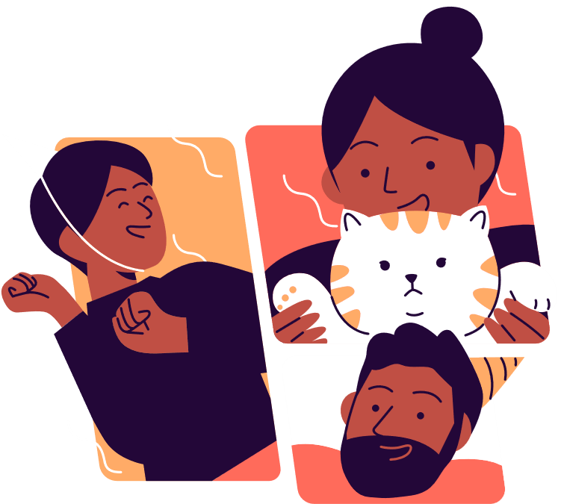
Community Conversation and Landscape Analysis Results

Slide 6
Community Landscape Analysis
Transition Assets
DARS
DBHDS
WWRC
Project SEARCH
CTI
RIL
SOAR365
Recommendations for Improving Employment
Better employer outreach
Education
  Transition Specialists
  Youth with IDD and families
Collaboration
Gathering Community Perspectives
Community Conversations (2)
Photovoice
Business Insight Questionnaire
Barriers to Employment
Low expectations for youth with IDD
Lack of knowledge
Fear
Notes:
Layout of the landscape analysis
Questions to ask:
What kinds of barriers to employment are missing?
What recommendations for improving employment are missing?
Do these conclusions reflect what you heard in our first two community conversations, or are we missing something?
Is there a finding here that you don’t agree with?

Slide 7
Community Conversations 1: Overview
Partnerships
2. Education
Notes:
Partnerships:
Schools and employers
Service agencies/providers and schools
Employers and service agencies
Education:
For educators, employers, and youth with IDD
Goal is to raise employment expectations/standards, reduce fear and bias, and promote asset-based thinking
We do this through sharing narratives/success stories, partnerships and mentoring, and using technology (social media)

Slide 8
Community Conversations 2: Results
Notes:
Hyperlink to CC2 Infographic
Questions to ask participants:

Slide 9
What’s our Response to the Landscape Analysis?

Slide 10

Preparing IS Teachers and Students
Preparing students, families, and businesses
Increasing independence at work
Student work-based assessments
Employment First in home, school and community
Strengths based career planning
How to match students with work based experiences

Slide 11
Year 2 Overview
Photovoice & virtual asset mapping
Community Collaboration for Employment Transition
  Commitment
  Role clarification
Develop a PLAN for employment transition

Slide 12

Main Activity: Visioning
Notes:
https://jamboard.google.com/d/1-jatVG2-LALcC1uYy8Am956hw_fS_9jnyhbrqSJw33w/edit?usp=sharing

Slide 13
Consent Discussion
Purpose: to inform you of your roles and rights as participants ?”
What is your role?
What should you know about your rights as participants?
  Privacy
  Benefits and Risks
  Data Security
  Withdrawal from Community Conversations
  Approved by VCU IRB
  Compensation
To participate in Community Conversations, you need to give verbal consent.
To make this easy and accessible for everyone, simply type “yes” in the chat OR use the “yes” reaction on zoom if you would like to participate.
More detailed information is provided in the consent document you received via email. If you would like us to resend this document, please reach out to projectpeace@vcu.edu.

Slide 14
United Way
YMCA
Habitat for Humanity
Vision Statements
United Way envisions a community where all individuals and families achieve their human potential through education, financial stability and healthy lives.
We envision a future in which all people – no matter who they are or where they come from – get the support they need, when they need it, to reach their full potential.
A world where everyone has a decent place to live.

Slide 15
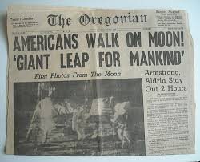
Hopeful Headline

Slide 16

The Vision Formula
Do what? | For Whom? | To Achieve?
 | Richmond youth with IDD Greatest support needs Intensive supports classes

Slide 17

Drafting Vision Statements

Slide 18
Wrapping-up & Looking Forward

Slide 19

Feedback
PLEASE help us strengthen our Community Collaborative for Employment Transition

Slide 20
Who’s NOT here?
Whose voices are we missing in this planning process?
Strategies to bring them in?
Notes:
Speaker notes:The focus of this discussion is on who we need to get to the table. This will be a 5 minute discussion. We will focus on developing a list of people who need to be at the table. We will also discuss strategies to recruit additional self advocates and families. What supports do they need?

Slide 21
Planning Agenda & Activities
When | Description | Day/Time
January | AIMs approval Commitment Brainswarming | Preferences?
February | SMARTIE goals Responsibilities
March | Implementation timeline Logistics
April | Finalize plans and send to RPS partners

Slide 22
Compensation
We WANT to pay you for your time
You MUST complete the registration/compensation form to receive gift cards
REDCap used for collecting info:
https://redcap.vcu.edu/surveys/?s=Y8WCFTAE4KRK7H8M

Slide 23
Thanks!
Do you have any questions?
projectpeace@vcu.edu
Follow us on Social Media! @projectpeace_VA
Please keep this slide for attribution

Slide 24
Resources
Community Landscape Analysis 1.0
Community Conversations 1 Infographic
Community Conversations 2 Infographic

